Slide 1
Lecture 5 Network Security-Attacks
modified from slides of Lawrie Brown
Notes:
This chapter examines the wide spectrum of malware threats and countermeasures.
We begin with a survey of various types of malware, and offer a broad
classification based first on the means malware uses to spread or propagate , and
then on the variety of actions or payloads used once the malware has reached a
target. Propagation mechanisms include those used by viruses, worms, and Trojans.
Payloads include system corruption, bots, phishing, spyware, and rootkits. The
discussion concludes with a review of countermeasure approaches.

Slide 2

Malware
Notes:
Malicious software , or malware , arguably constitutes one of the most significant categories
of threats to computer systems. [NIST05] defines malware as “a program that
is inserted into a system, usually covertly, with the intent of compromising the confidentiality,
integrity, or availability of the victim’s data, applications, or operating
system or otherwise annoying or disrupting the victim.” Hence, we are concerned
with the threat malware poses to application programs, to utility programs, such as
editors and compilers, and to kernel-level programs. We are also concerned with
its use on compromised or malicious Web sites and servers, or in especially crafted
spam e-mails or other messages, which aim to trick users into revealing sensitive
personal information.

Slide 3
Malware
[NIST05] defines malware as:
“a program that is inserted into a system, usually covertly, with the intent of compromising the confidentiality, integrity, or availability of the victim’s data, applications, or operating system or otherwise annoying or disrupting the victim.”
Notes:
Malicious software , or malware , arguably constitutes one of the most significant categories
of threats to computer systems. [NIST05] defines malware as “a program that
is inserted into a system, usually covertly, with the intent of compromising the confidentiality,
integrity, or availability of the victim’s data, applications, or operating
system or otherwise annoying or disrupting the victim.” Hence, we are concerned
with the threat malware poses to application programs, to utility programs, such as
editors and compilers, and to kernel-level programs. We are also concerned with
its use on compromised or malicious Web sites and servers, or in especially crafted
spam e-mails or other messages, which aim to trick users into revealing sensitive
personal information.

Slide 4
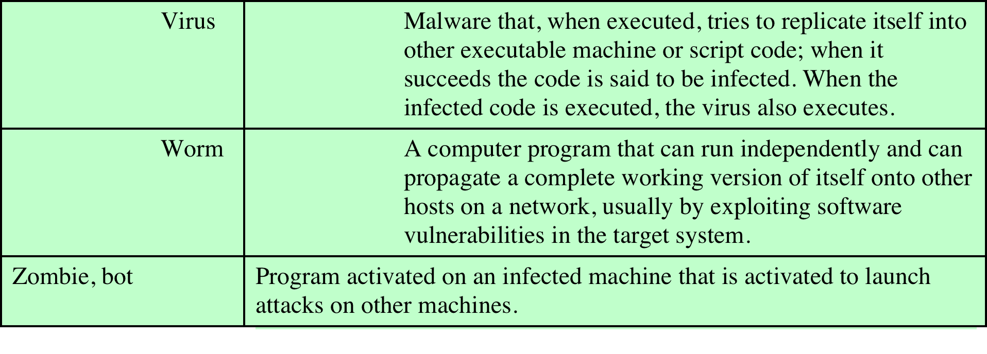
Malware
Notes:
Malicious software , or malware , arguably constitutes one of the most significant categories
of threats to computer systems. [NIST05] defines malware as “a program that
is inserted into a system, usually covertly, with the intent of compromising the confidentiality,
integrity, or availability of the victim’s data, applications, or operating
system or otherwise annoying or disrupting the victim.” Hence, we are concerned
with the threat malware poses to application programs, to utility programs, such as
editors and compilers, and to kernel-level programs. We are also concerned with
its use on compromised or malicious Web sites and servers, or in especially crafted
spam e-mails or other messages, which aim to trick users into revealing sensitive
personal information.

Slide 5
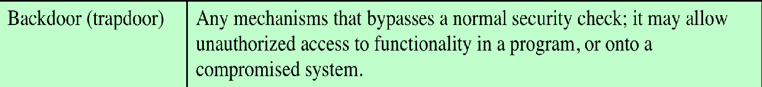
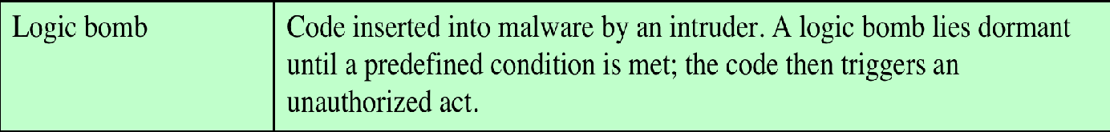
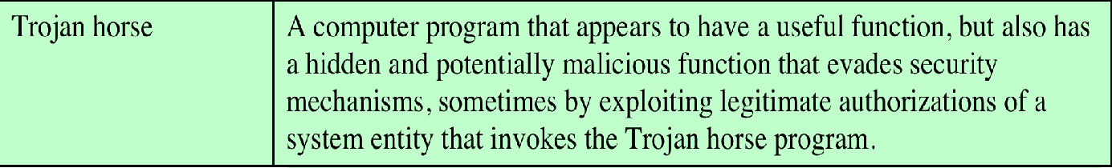
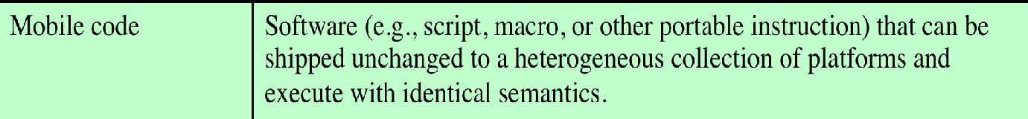
Terminology
Programmers can use Backdoors for software maintenance purposes

Slide 6
Classification of Malware
classified into two broad categories based on:
how it spreads or propagates to reach the desired targets
the actions or payloads it performs once a target is reached
also classified by:
those that need a host program
parasitic code such as viruses
those that are independent, self-contained programs
worms, trojans, and bots
malware that does not replicate
trojans and spam e-mail
malware that does replicate
viruses and worms
Notes:
A number of authors attempt to classify malware, as shown in the survey and proposal
of [HANS04]. Although a range of aspects can be used, one useful approach
classifies malware into two broad categories, based first on how it spreads or propagates
to reach the desired targets; and then on the actions or payloads it performs
once a target is reached.
Earlier approaches to malware classification distinguished between those that
need a host program, being parasitic code such as viruses, and those that are independent,
self-contained programs run on the system such as worms, trojans, and
bots. Another distinction used was between malware that does not replicate, such as
trojans and spam e-mail, and malware that does, including viruses and worms.

Slide 7
Types of Malicious Software
propagation mechanisms include:
infection of existing content by viruses that is subsequently spread to other systems
exploit of software vulnerabilities by worms or drive-by-downloads to allow the malware to replicate
social engineering attacks that convince users to bypass security mechanisms to install Trojans or to respond to phishing attacks
payload actions performed by malware once it reaches a target system can include:
corruption of system or data files
theft of service/make the system a zombie agent of attack as part of a botnet
theft of information from the system/keylogging
stealthing/hiding its presence on the system
Notes:
Propagation mechanisms include infection of existing executable or interpreted
content by viruses that is subsequently spread to other systems; exploit of software
vulnerabilities either locally or over a network by worms or drive-by-downloads to
allow the malware to replicate; and social engineering attacks that convince users to
bypass security mechanisms to install trojans, or to respond to phishing attacks.
Earlier approaches to malware classification distinguished between those that
need a host program, being parasitic code such as viruses, and those that are independent,
self-contained programs run on the system such as worms, trojans, and
bots. Another distinction used was between malware that does not replicate, such as
trojans and spam e-mail, and malware that does, including viruses and worms.
Payload actions performed by malware once it reaches a target system can
include corruption of system or data files; theft of service in order to make the
system a zombie agent of attack as part of a botnet; theft of information from the
system, especially of logins, passwords, or other personal details by keylogging or
spyware programs; and stealthing where the malware hides its presence on the
system from attempts to detect and block it.
While early malware tended to use a single means of propagation to deliver
a single payload, as it evolved, we see a growth of blended malware that incorporates
a range of both propagation mechanisms and payloads that increase its ability
to spread, hide, and perform a range of actions on targets. A blended attack uses
multiple methods of infection or propagation, to maximize the speed of contagion
and the severity of the attack. Some malware even support an update mechanism
that allows it to change the range of propagation and payload mechanisms utilized
once it is deployed.
In the following sections, we survey these various categories of malware, and
then follow with a discussion of appropriate countermeasures.

Slide 8
1 - Viruses
piece of software that infects programs
modifies them to include a copy of the virus
replicates and goes on to infect other content
easily spread through network environments
when attached to an executable program a virus can do anything that the program is permitted to do
executes secretly when the host program is run
specific to operating system and hardware
takes advantage of their details and weaknesses
Notes:
The first category of malware propagation concerns parasitic software fragments
that attach themselves to some existing executable content. The fragment may be
machine code that infects some existing application, utility, or system program, or
even the code used to boot a computer system. More recently, the fragment has
been some form of scripting code, typically used to support active content within
data files such as Microsoft Word documents, Excel spreadsheets, or Adobe PDF
documents.
A computer virus is a piece of software that can “infect” other programs, or indeed
any type of executable content, by modifying them. The modification includes
injecting the original code with a routine to make copies of the virus code, which
can then go on to infect other content. Computer viruses first appeared in the early
1980s, and the term itself is attributed to Fred Cohen. Cohen is the author of a
groundbreaking book on the subject [COHE94]. The Brain virus, first seen in 1986,
was one of the first to target MSDOS systems, and resulted in a significant number
of infections for this time.
Biological viruses are tiny scraps of genetic code—DNA or RNA—that
can take over the machinery of a living cell and trick it into making thousands of
flawless replicas of the original virus. Like its biological counterpart, a computer
virus carries in its instructional code the recipe for making perfect copies of itself.
The typical virus becomes embedded in a program, or carrier of executable content,
on a computer. Then, whenever the infected computer comes into contact with an
uninfected piece of code, a fresh copy of the virus passes into the new location.
Thus, the infection can spread from computer to computer, aided by unsuspecting
users, who exchange these programs or carrier files on disk or USB stick; or who
send them to one another over a network. In a network environment, the ability to
access documents, applications, and system services on other computers provides a
perfect culture for the spread of such viral code.
A virus that attaches to an executable program can do anything that the
program is permitted to do. It executes secretly when the host program is run. Once
the virus code is executing, it can perform any function, such as erasing files and
programs, that is allowed by the privileges of the current user. One reason viruses
dominated the malware scene in earlier years was the lack of user authentication
and access controls on personal computer systems at that time. This enabled a virus
to infect any executable content on the system. The significant quantity of programs
shared on floppy disk also enabled its easy, if somewhat slow, spread. The inclusion
of tighter access controls on modern operating systems significantly hinders the
ease of infection of such traditional, machine executable code, viruses. This resulted
in the development of macro viruses that exploit the active content supported
by some documents types, such as Microsoft Word or Excel files, or Adobe PDF
documents. Such documents are easily modified and shared by users as part of their
normal system use, and are not protected by the same access controls as programs.
Currently, a viral mode of infection is typically one of several propagation mechanisms
used by contemporary malware, which may also include worm and Trojan
capabilities.

Slide 9
1 .Viruses-Virus Components
infection mechanism
means by which a virus spreads or propagates
also referred to as the infection vector
trigger
event or condition that determines when the payload is activated or delivered
sometimes known as a logic bomb
payload
what the virus does (besides spreading)
may involve damage or benign but noticeable activity
Notes:
[AYCO06] states that a computer virus has three parts. More generally, many
contemporary types of malware also include one or more variants of each of these
components:
• Infection mechanism : The means by which a virus spreads or propagates,
enabling it to replicate. The mechanism is also referred to as the infection
vector .
• Trigger: The event or condition that determines when the payload is activated
or delivered, sometimes known as a logic bomb .
• Payload: What the virus does, besides spreading. The payload may involve
damage or may involve benign but noticeable activity.

Slide 10
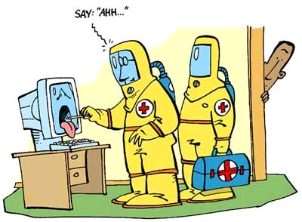
1 .Viruses-Virus Phases
dormant phase
virus is idle
will eventually be activated by some event
not all viruses have this stage
triggering phase
virus is activated to perform the function for which it was intended
can be caused by a variety of system events
propagation phase
virus places a copy of itself into other programs or into certain system areas on the disk
may not be identical to the propagating version
each infected program will now contain a clone of the virus which will itself enter a propagation phase
execution phase
function is performed
may be harmless or damaging
Notes:
During its lifetime, a typical virus goes through the following four phases:
• Dormant phase: The virus is idle. The virus will eventually be activated by
some event, such as a date, the presence of another program or file, or the
capacity of the disk exceeding some limit. Not all viruses have this stage.
• Propagation phase: The virus places a copy of itself into other programs or
into certain system areas on the disk. The copy may not be identical to the
propagating version; viruses often morph to evade detection. Each infected
program will now contain a clone of the virus, which will itself enter a propagation
phase.
• Triggering phase: The virus is activated to perform the function for which it
was intended. As with the dormant phase, the triggering phase can be caused
by a variety of system events, including a count of the number of times that
this copy of the virus has made copies of itself.
• Execution phase: The function is performed. The function may be harmless,
such as a message on the screen, or damaging, such as the destruction of
programs and data files.
Most viruses that infect executable program files carry out their work in a
manner that is specific to a particular operating system and, in some cases, specific
to a particular hardware platform. Thus, they are designed to take advantage of the
details and weaknesses of particular systems. Macro viruses though, target specific
document types, which are often supported on a variety of systems.

Slide 11
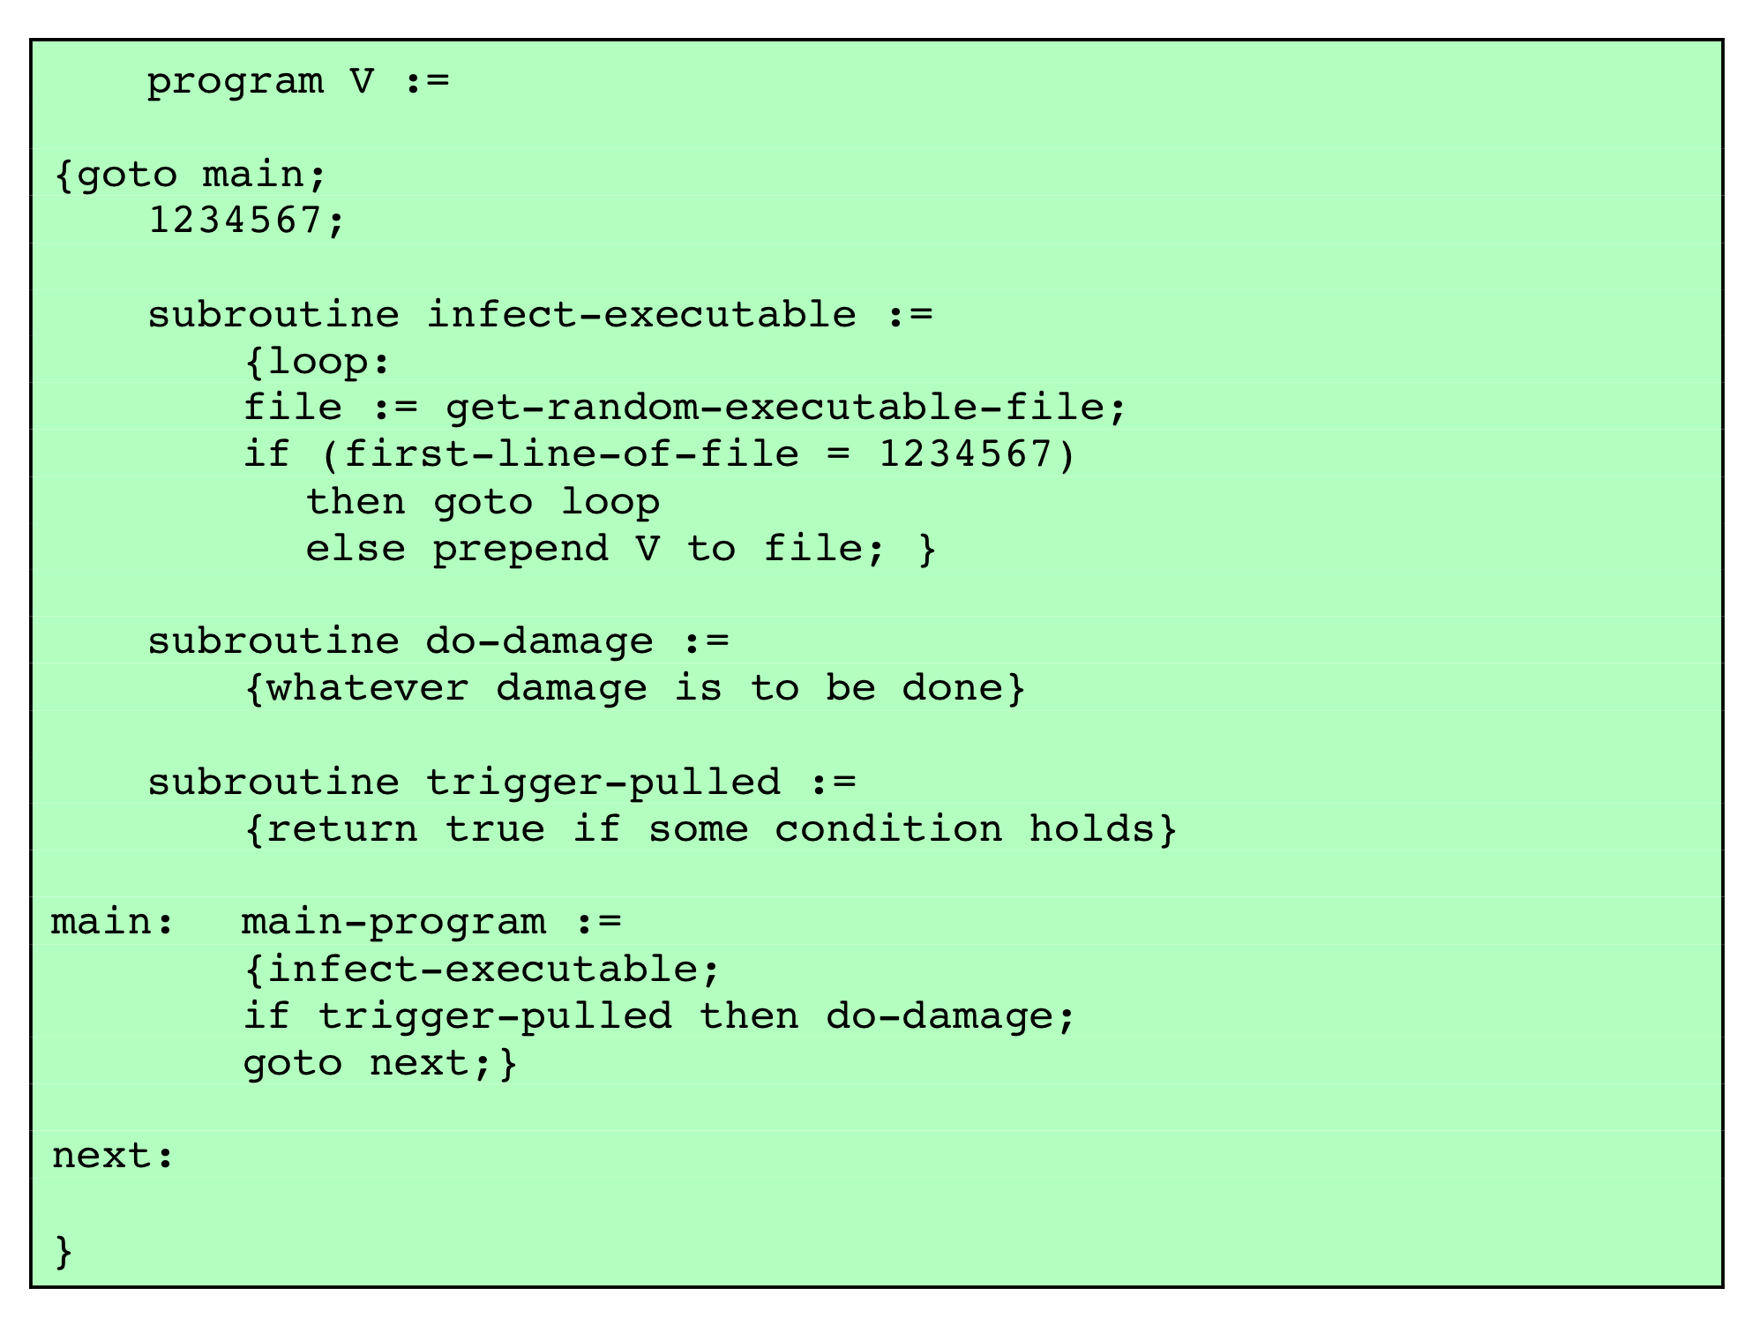
1 .Viruses-Virus Structure
Notes:
A traditional, machine executable code, virus can
be prepended or postpended to some executable program, or it can be embedded
into it in some other fashion. The key to its operation is that the infected program,
when invoked, will first execute the virus code and then execute the original code
of the program.
A very general depiction of virus structure is shown in Figure 6.1 (based on
[COHE94]). In this case, the virus code, V, is prepended to infected programs, and
it is assumed that the entry point to the program, when invoked, is the first line of
the program.
The infected program begins with the virus code and works as follows. The
first line of code is a jump to the main virus program. The second line is a special
marker that is used by the virus to determine whether or not a potential victim
program has already been infected with this virus. When the program is invoked,
control is immediately transferred to the main virus program. The virus program
may first seek out uninfected executable files and infect them. Next, the virus may
execute its payload if the required trigger conditions, if any, are met. Finally, the
virus transfers control to the original program. If the infection phase of the program
is reasonably rapid, a user is unlikely to notice any difference between the execution
of an infected and an uninfected program.

Slide 12
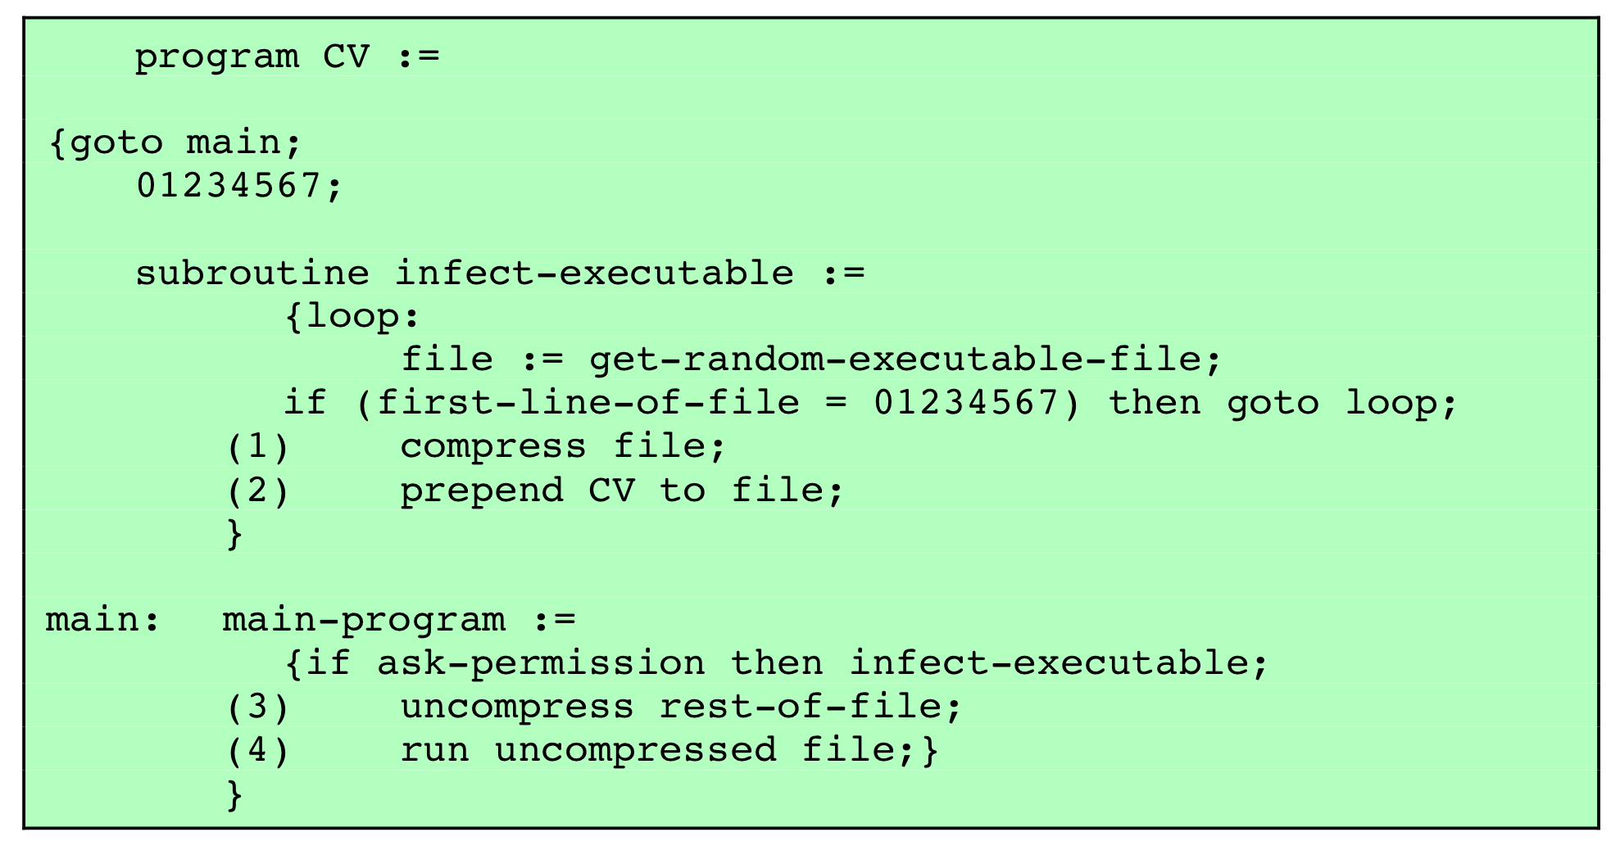
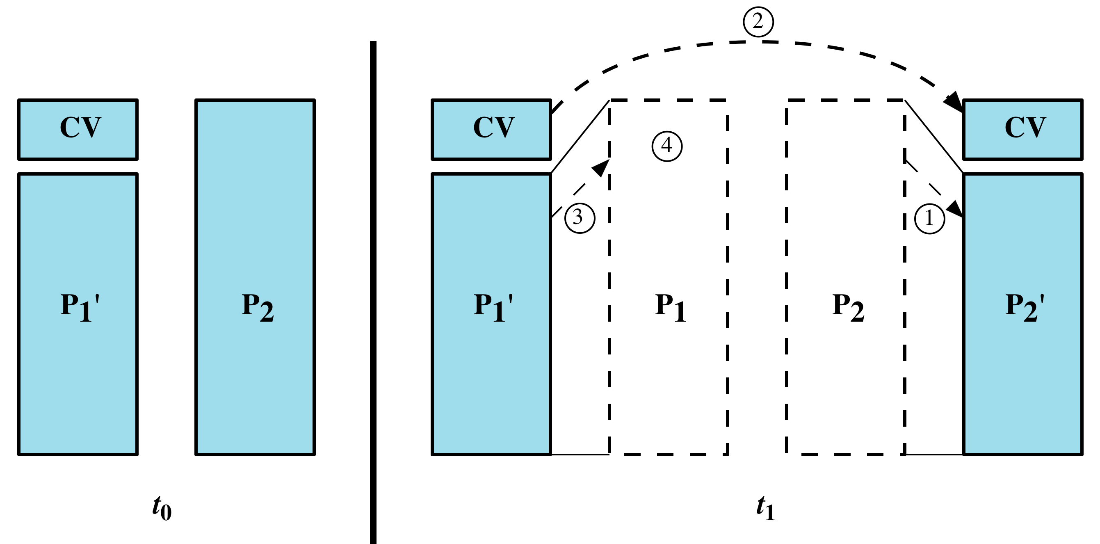
1 .Viruses-Compression Virus Logic
Notes:
A virus such as the one just described is easily detected because an infected
version of a program is longer than the corresponding uninfected one. A way to
thwart such a simple means of detecting a virus is to compress the executable file
so that both the infected and uninfected versions are of identical length. Figure 6.2
shows in general terms the logic required. The key lines in this virus are numbered,
and Figure 6.3 illustrates the operation.

Slide 13
1 .Viruses-Virus Classifications
target
concealment strategy
boot sector infector
infects a master boot record or boot record and spreads when a system is booted from the disk containing the virus
file infector
infects files that the operating system or shell considers to be executable
macro virus
infects files with macro or scripting code that is interpreted by an application
multipartite virus
infects files in multiple ways
encrypted virus
a portion of the virus creates a random encryption key and encrypts the remainder of the virus
stealth virus
a form of virus explicitly designed to hide itself from detection by anti-virus software
polymorphic virus
a virus that mutates with every infection
metamorphic virus
a virus that mutates and rewrites itself completely at each iteration and may change behavior as well as appearance
Notes:
There has been a continuous arms race between virus writers and writers of
anti-virus software since viruses first appeared. As effective countermeasures are
developed for existing types of viruses, newer types are developed. There is no
simple or universally agreed upon classification scheme for viruses. In this section,
we follow [AYCO06] and classify viruses along two orthogonal axes: the type of
target the virus tries to infect and the method the virus uses to conceal itself from
detection by users and anti-virus software.
A virus classification by target includes the following categories:
• Boot sector infector: Infects a master boot record or boot record and spreads
when a system is booted from the disk containing the virus.
• File infector: Infects files that the operating system or shell consider to be
executable.
• Macro virus : Infects files with macro or scripting code that is interpreted by an
application.
• Multipartite virus: Infects files in multiple ways. Typically, the multipartite
virus is capable of infecting multiple types of files, so that virus eradication
must deal with all of the possible sites of infection.
A virus classification by concealment strategy includes the following categories:
• Encrypted virus: A typical approach is as follows. A portion of the virus creates
a random encryption key and encrypts the remainder of the virus. The key is
stored with the virus. When an infected program is invoked, the virus uses the
stored random key to decrypt the virus. When the virus replicates, a different
random key is selected. Because the bulk of the virus is encrypted with a different
key for each instance, there is no constant bit pattern to observe.
Stealth virus : A form of virus explicitly designed to hide itself from detection
by anti-virus software. Thus, the entire virus, not just a payload is hidden. It
may use both code mutation, for example compression, and rootkit techniques
to achieve this.
• Polymorphic virus: A virus that mutates with every infection, making detection
by the “signature” of the virus impossible.
• Metamorphic virus : As with a polymorphic virus, a metamorphic virus mutates
with every infection. The difference is that a metamorphic virus rewrites itself
completely at each iteration, increasing the difficulty of detection. Metamorphic
viruses may change their behavior as well as their appearance.
A polymorphic virus creates copies during replication that are functionally equivalent
but have distinctly different bit patterns, in order to defeat programs that scan
for viruses. In this case, the “signature” of the virus will vary with each copy. To
achieve this variation, the virus may randomly insert superfluous instructions or
interchange the order of independent instructions. A more effective approach is to
use encryption. The strategy of the encryption virus is followed. The portion of the
virus that is responsible for generating keys and performing encryption/decryption
is referred to as the mutation engine . The mutation engine itself is altered with
each use.

Slide 14
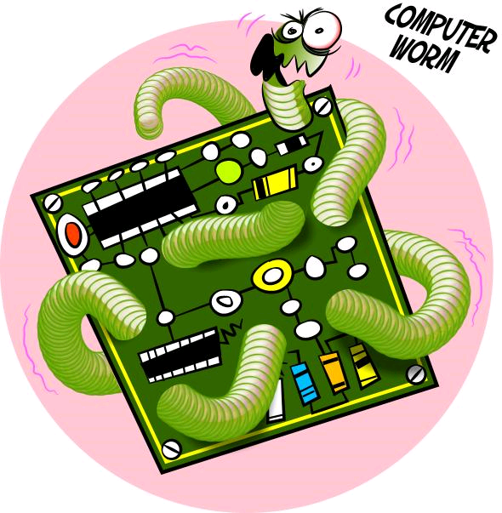
2.Worms
program that actively seeks out more machines to infect
each infected machine serves as an automated launching pad for attacks on other machines
exploits software vulnerabilities in client or server programs
can use network connections to spread from system to system
spreads through shared media
USB drives, CD, DVD data disks
Notes:
The next category of malware propagation concerns the exploit of software
vulnerabilities, such as those we discuss in Chapters 10 and 11 , which are commonly
exploited by computer worms. A worm is a program that actively seeks out
more machines to infect, and then each infected machine serves as an automated
launching pad for attacks on other machines. Worm programs exploit software
vulnerabilities in client or server programs to gain access to each new system. They
can use network connections to spread from system to system. They can also spread
through shared media, such as USB drives or CD and DVD data disks. E-mail
worms spread in macro or script code included in documents attached to e-mail or
to instant messenger file transfers. Upon activation, the worm may replicate and
propagate again. In addition to propagation, the worm usually carries some form of
payload, such as those we discuss later.
The concept of a computer worm was introduced in John Brunner’s 1975 SF
novel The Shockwave Rider . The first known worm implementation was done in
Xerox Palo Alto Labs in the early 1980s. It was nonmalicious, searching for idle
systems to use to run a computationally intensive task.

Slide 15
2.Worms
e-mail worms spread in macro or script code included in attachments and instant messenger file transfers
upon activation the worm may replicate and propagate again
usually carries some form of payload
Zero day exploit: The worm is launched and active before discovery
Notes:
The next category of malware propagation concerns the exploit of software
vulnerabilities, such as those we discuss in Chapters 10 and 11 , which are commonly
exploited by computer worms. A worm is a program that actively seeks out
more machines to infect, and then each infected machine serves as an automated
launching pad for attacks on other machines. Worm programs exploit software
vulnerabilities in client or server programs to gain access to each new system. They
can use network connections to spread from system to system. They can also spread
through shared media, such as USB drives or CD and DVD data disks. E-mail
worms spread in macro or script code included in documents attached to e-mail or
to instant messenger file transfers. Upon activation, the worm may replicate and
propagate again. In addition to propagation, the worm usually carries some form of
payload, such as those we discuss later.
The concept of a computer worm was introduced in John Brunner’s 1975 SF
novel The Shockwave Rider . The first known worm implementation was done in
Xerox Palo Alto Labs in the early 1980s. It was nonmalicious, searching for idle
systems to use to run a computationally intensive task.

Slide 16
2.Worms-Worm Replication
electronic mail or instant messenger facility
worm e-mails a copy of itself to other systems
sends itself as an attachment via an instant message service
file sharing
creates a copy of itself or infects a file as a virus on removable media
remote execution capability
worm executes a copy of itself on another system
remote file access or transfer capability
worm uses a remote file access or transfer service to copy itself from one system to the other
remote login capability
worm logs onto a remote system as a user and then uses commands to copy itself from one system to the other
Notes:
To replicate itself, a worm uses some means to access remote systems. These
include the following, most of which are still seen in active use [SYMA11]:
• Electronic mail or instant messenger facility: A worm e-mails a copy of itself to
other systems, or sends itself as an attachment via an of instant message service,
so that its code is run when the e-mail or attachment is received or viewed.
• File sharing: A worm either creates a copy of itself or infects other suitable
files as a virus on removable media such as a USB drive; it then executes when
the drive is connected to another system using the autorun mechanism by
exploiting some software vulnerability, or when a user opens the infected file
on the target system.
• Remote execution capability: A worm executes a copy of itself on another
system, either by using an explicit remote execution facility or by exploiting a
program flaw in a network service to subvert its operations (as we discuss in
Chapters 10 and 11 ).
• Remote file access or transfer capability: A worm uses a remote file access or
transfer service to another system to copy itself from one system to the other,
where users on that system may then execute it.
• Remote login capability: A worm logs onto a remote system as a user and
then uses commands to copy itself from one system to the other, where it then
executes.
The new copy of the worm program is then run on the remote system where, in
addition to any payload functions that it performs on that system, it continues to
propagate.
A worm typically uses the same phases as a computer virus: dormant, propagation,
triggering, and execution. The propagation phase generally performs the
following functions:
• Search for appropriate access mechanisms to other systems to infect by examining
host tables, address books, buddy lists, trusted peers, and other similar
repositories of remote system access details; by scanning possible target host
addresses; or by searching for suitable removable media devices to use.
• Use the access mechanisms found to transfer a copy of itself to the remote
system, and cause the copy to be run.
The worm may also attempt to determine whether a system has previously
been infected before copying itself to the system. In a multiprogramming system,
it can also disguise its presence by naming itself as a system process or using some
other name that may not be noticed by a system operator. More recent worms can
even inject their code into existing processes on the system, and run using additional
threads in that process, to further disguise their presence.

Slide 17
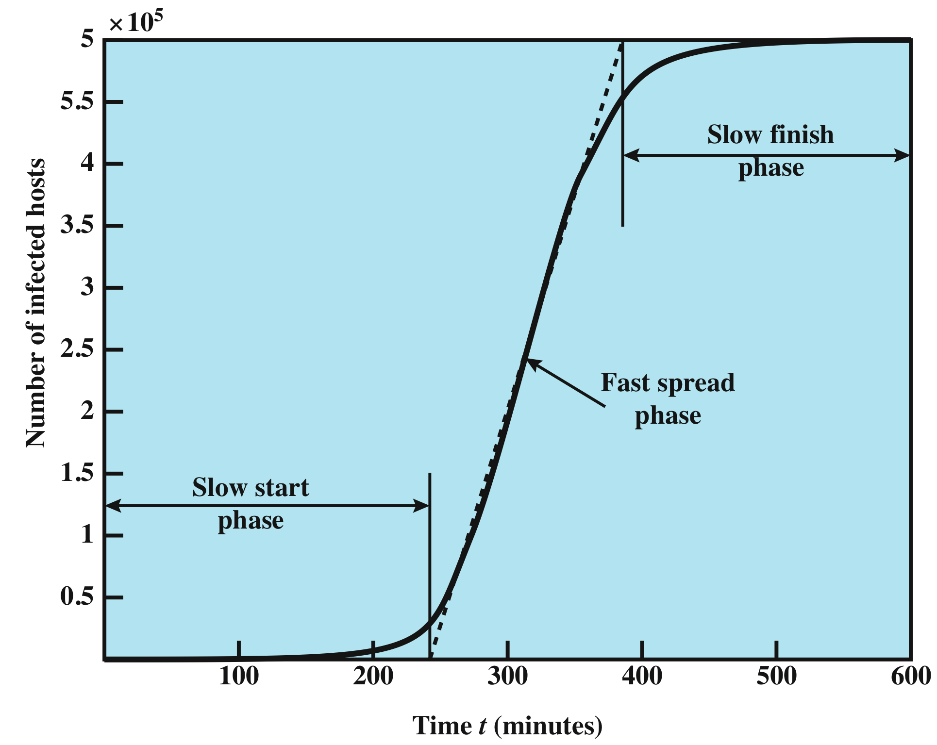
2.Worms-Worm Propagation Model
Notes:
[ZOU05] describes a model for worm propagation based on an analysis of network
worm attacks at that time. The speed of propagation and the total number of hosts
infected depend on a number of factors, including the mode of propagation, the
vulnerability or vulnerabilities exploited, and the degree of similarity to preceding
attacks. For the latter factor, an attack that is a variation of a recent previous attack
may be countered more effectively than a more novel attack. Figure 6.4 shows
the dynamics for one typical set of parameters. Propagation proceeds through three
phases. In the initial phase, the number of hosts increases exponentially. To see
that this is so, consider a simplified case in which a worm is launched from a single
host and infects two nearby hosts. Each of these hosts infects two more hosts, and
so on. This results in exponential growth. After a time, infecting hosts waste some
time attacking already infected hosts, which reduces the rate of infection. During
this middle phase, growth is approximately linear, but the rate of infection is rapid.
When most vulnerable computers have been infected, the attack enters a slow finish
phase as the worm seeks out those remaining hosts that are difficult to identify.
Clearly, the objective in countering a worm is to catch the worm in its slow
start phase, at a time when few hosts have been infected.

Slide 18
3. Bots: Attack Agents
Bots: takes over another Internet attached computer and uses that computer to launch or manage attacks
Botnet: collection of bots capable of acting in a coordinated manner
distributed denial-of-service (DDoS) attacks
spamming
sniffing traffic
Keylogging - captures keystrokes to allow attacker to monitor sensitive information
spreading new malware
installing advertisement add-ons and browser helper objects attacking IRC chat networks
Notes:
The next category of payload we discuss is where the malware subverts the computational
and network resources of the infected system for use by the attacker.
Such a system is known as a bot (robot), zombie or drone, and secretly takes over
another Internet-attached computer and then uses that computer to launch or manage
attacks that are difficult to trace to the bot’s creator. The bot is typically planted
on hundreds or thousands of computers belonging to unsuspecting third parties.
The collection of bots often is capable of acting in a coordinated manner; such a
collection is referred to as a botnet . This type of payload attacks the integrity and
availability of the infected system.
Uses of Bots
[HONE05] lists the following uses of bots:
• Distributed denial-of-service (DDoS) attacks: A DDoS attack is an attack on
a computer system or network that causes a loss of service to users. We examine
DDoS attacks in Chapter 7 .
• Spamming: With the help of a botnet and thousands of bots, an attacker is able
to send massive amounts of bulk e-mail (spam).
• Sniffing traffic: Bots can also use a packet sniffer to watch for interesting cleartext
data passing by a compromised machine. The sniffers are mostly used to
retrieve sensitive information like usernames and passwords.
Keylogging: If the compromised machine uses encrypted communication
channels (e.g. HTTPS or POP3S), then just sniffing the network packets on
the victim’s computer is useless because the appropriate key to decrypt the
packets is missing. But by using a keylogger, which captures keystrokes on the
infected machine, an attacker can retrieve sensitive information.
• Spreading new malware: Botnets are used to spread new bots. This is very
easy since all bots implement mechanisms to download and execute a file via
HTTP or FTP. A botnet with 10,000 hosts that acts as the start base for a
worm or mail virus allows very fast spreading and thus causes more harm.
• Installing advertisement add-ons and browser helper objects (BHOs): Botnets
can also be used to gain financial advantages. This works by setting up a fake
Web site with some advertisements: The operator of this Web site negotiates a
deal with some hosting companies that pay for clicks on ads. With the help of
a botnet, these clicks can be “automated” so that instantly a few thousand bots
click on the pop-ups. This process can be further enhanced if the bot hijacks
the start-page of a compromised machine so that the “clicks” are executed
each time the victim uses the browser.
• Attacking IRC chat networks: Botnets are also used for attacks against
Internet Relay Chat (IRC) networks. Popular among attackers is especially
the so-called clone attack: In this kind of attack, the controller orders each bot
to connect a large number of clones to the victim IRC network. The victim is
flooded by service requests from thousands of bots or thousands of channeljoins
by these cloned bots. In this way, the victim IRC network is brought
down, similar to a DDoS attack.
• Manipulating online polls/games: Online polls/games are getting more and
more attention and it is rather easy to manipulate them with botnets. Since
every bot has a distinct IP address, every vote will have the same credibility as
a vote cast by a real person. Online games can be manipulated in a similar way.

Slide 19
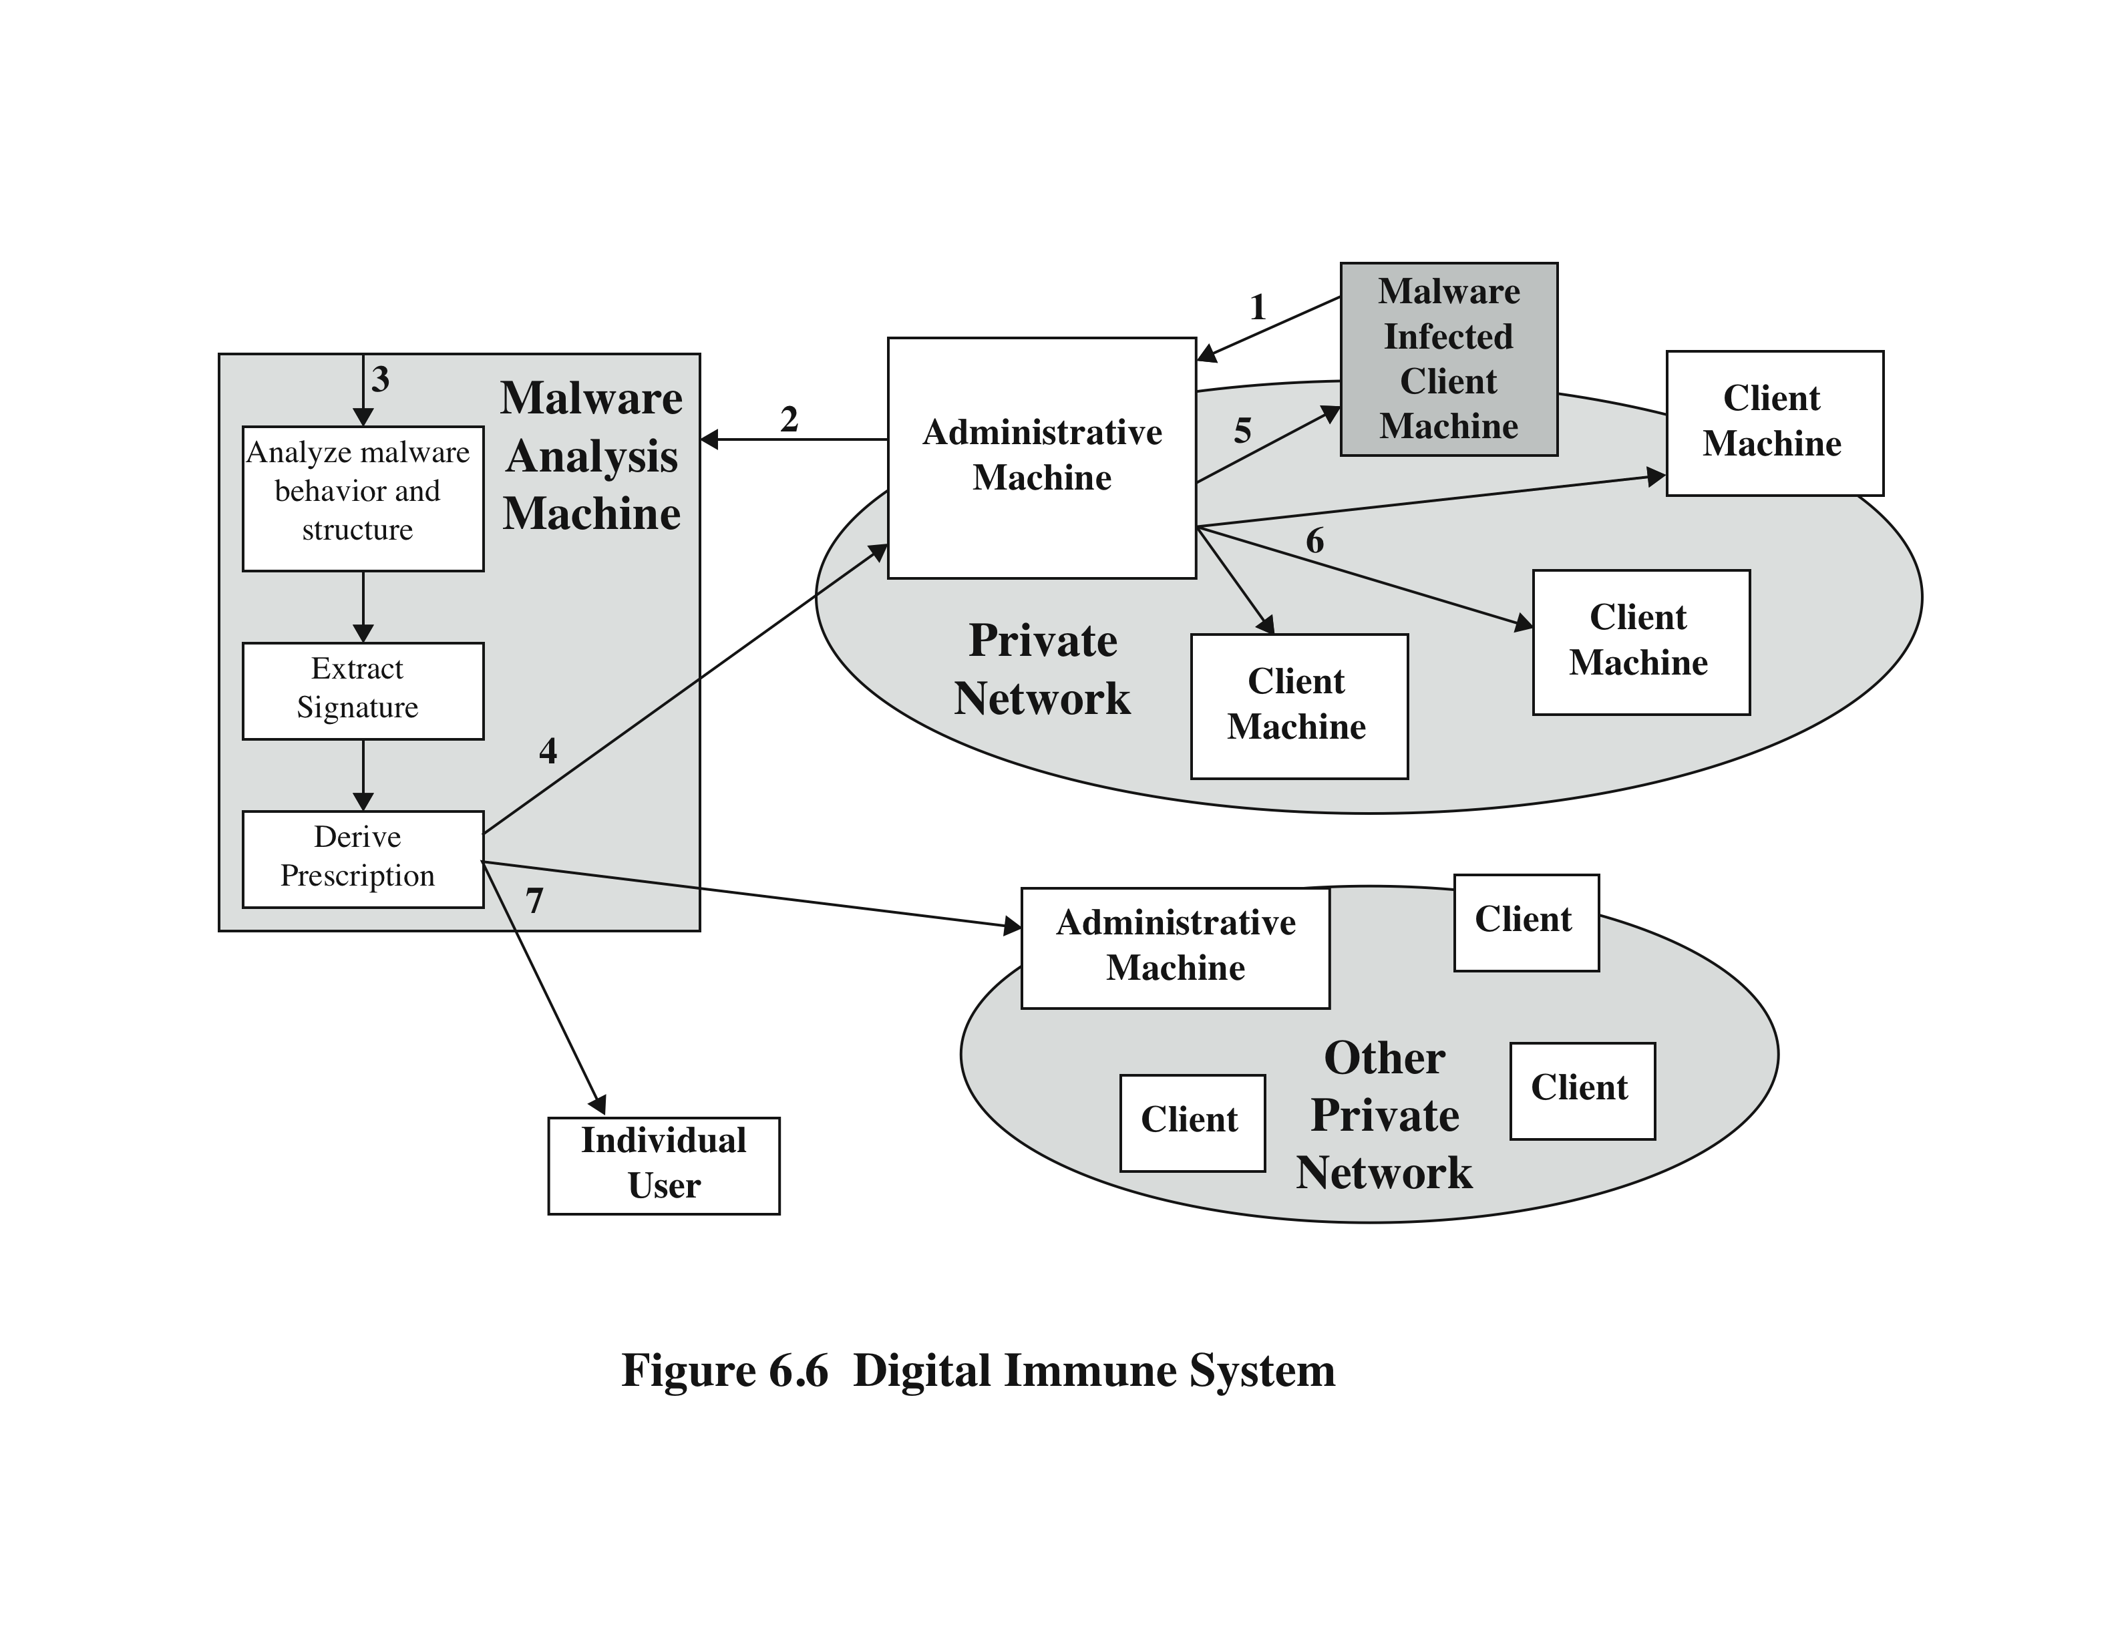
Digital Immune System
Notes:
The digital immune system is a comprehensive
approach to virus protection developed by IBM [KEPH97a, KEPH97b, WHIT99]
and subsequently refined by Symantec [SYMA01]. In 2010, their resulting Global
Intelligence Network comprised more than 240,000 sensors, and gathered intelligence
on malicious code from more than 133 million client, server, and gateway systems
that have deployed Symantec anti-virus products [SYMA11]. The motivation for
this development has been the rising threat of Internet-based virus propagation, and
the need to acquire a global view of the situation.
Traditionally, the virus threat was characterized by the relatively slow spread
of new viruses and new mutations. Anti-virus software was typically updated on a
monthly basis, and this was sufficient to control the problem. Also traditionally, the
Internet played a comparatively small role in the spread of viruses. But as [CHES97]
points out, two major trends in Internet technology have had an increasing impact
on the rate of virus propagation over recent decades:
• Integrated mail systems: Systems such as Lotus Notes and Microsoft Outlook
make it very simple to send anything to anyone and to work with objects that
are received.
• Mobile-program systems: Capabilities such as Java and ActiveX allow
programs to move on their own from one system to another.
In response to the threat posed by these Internet-based capabilities, IBM
developed the original prototype digital immune system. This system expands on
the use of program emulation, discussed in the preceding subsection, and provides
a general-purpose emulation and malware detection system. The objective of this
system is to provide rapid response time so that malware can be stamped out almost
as soon as they are introduced. When new malware enters an organization, the
immune system automatically captures it, analyzes it, adds detection and shielding
for it, removes it, and passes information about it to client systems, so the malware
can be detected before it is allowed to run elsewhere.
Figure 6.6 illustrates the typical steps in early proposals for digital immune
system operation:
1. A monitoring program on each PC uses a variety of heuristics based on system
behavior, suspicious changes to programs, or family signature to infer that
malware may be present. The monitoring program forwards a copy of any
suspect program to an administrative machine within the organization.
The administrative machine encrypts the sample and sends it to a central
malware analysis system.
3. This machine creates an environment in which the suspect program can be
safely run for analysis. Techniques used for this purpose include emulation,
or the creation of a protected environment within which the suspect program
can be executed and monitored. The malware analysis system then produces a
prescription for identifying and removing the malware.
4. The resulting prescription is sent back to the administrative machine.
5. The administrative machine forwards the prescription to the original client.
6. The prescription is also forwarded to other clients in the organization.
7. Subscribers around the world receive regular anti-virus updates that protect
them from the new malware.

Slide 20
Digital Immune System
A monitoring program on each PC uses a variety of heuristics based on system
The administrative machine encrypts the sample and sends it to a central malware analysis system.
3. This machine creates an environment in which the suspect program can be safely run for analysis.
4. The resulting prescription is sent back to the administrative machine.
5. The administrative machine forwards the prescription to the original client.
6. The prescription is also forwarded to other clients in the organization.
7. Subscribers around the world receive regular anti-virus updates that protect them from the new malware.
Notes:
The digital immune system is a comprehensive
approach to virus protection developed by IBM [KEPH97a, KEPH97b, WHIT99]
and subsequently refined by Symantec [SYMA01]. In 2010, their resulting Global
Intelligence Network comprised more than 240,000 sensors, and gathered intelligence
on malicious code from more than 133 million client, server, and gateway systems
that have deployed Symantec anti-virus products [SYMA11]. The motivation for
this development has been the rising threat of Internet-based virus propagation, and
the need to acquire a global view of the situation.
Traditionally, the virus threat was characterized by the relatively slow spread
of new viruses and new mutations. Anti-virus software was typically updated on a
monthly basis, and this was sufficient to control the problem. Also traditionally, the
Internet played a comparatively small role in the spread of viruses. But as [CHES97]
points out, two major trends in Internet technology have had an increasing impact
on the rate of virus propagation over recent decades:
• Integrated mail systems: Systems such as Lotus Notes and Microsoft Outlook
make it very simple to send anything to anyone and to work with objects that
are received.
• Mobile-program systems: Capabilities such as Java and ActiveX allow
programs to move on their own from one system to another.
In response to the threat posed by these Internet-based capabilities, IBM
developed the original prototype digital immune system. This system expands on
the use of program emulation, discussed in the preceding subsection, and provides
a general-purpose emulation and malware detection system. The objective of this
system is to provide rapid response time so that malware can be stamped out almost
as soon as they are introduced. When new malware enters an organization, the
immune system automatically captures it, analyzes it, adds detection and shielding
for it, removes it, and passes information about it to client systems, so the malware
can be detected before it is allowed to run elsewhere.
Figure 6.6 illustrates the typical steps in early proposals for digital immune
system operation:
1. A monitoring program on each PC uses a variety of heuristics based on system
behavior, suspicious changes to programs, or family signature to infer that
malware may be present. The monitoring program forwards a copy of any
suspect program to an administrative machine within the organization.
The administrative machine encrypts the sample and sends it to a central
malware analysis system.
3. This machine creates an environment in which the suspect program can be
safely run for analysis. Techniques used for this purpose include emulation,
or the creation of a protected environment within which the suspect program
can be executed and monitored. The malware analysis system then produces a
prescription for identifying and removing the malware.
4. The resulting prescription is sent back to the administrative machine.
5. The administrative machine forwards the prescription to the original client.
6. The prescription is also forwarded to other clients in the organization.
7. Subscribers around the world receive regular anti-virus updates that protect
them from the new malware.

Slide 21
Denial Of Service Attacks
Notes:
Malicious software , or malware , arguably constitutes one of the most significant categories
of threats to computer systems. [NIST05] defines malware as “a program that
is inserted into a system, usually covertly, with the intent of compromising the confidentiality,
integrity, or availability of the victim’s data, applications, or operating
system or otherwise annoying or disrupting the victim.” Hence, we are concerned
with the threat malware poses to application programs, to utility programs, such as
editors and compilers, and to kernel-level programs. We are also concerned with
its use on compromised or malicious Web sites and servers, or in especially crafted
spam e-mails or other messages, which aim to trick users into revealing sensitive
personal information.

Slide 22
Denial-0f-Service (DoS) Attack
The NIST Computer Security Incident Handling Guide defines a DoS attack as:
“an action that prevents or impairs the authorized use of networks, systems, or applications by exhausting resources such as central processing units (CPU), memory, bandwidth, and disk space.”
Notes:
Denial of service is a form of attack on the availability of some service. In the context
of computer and communications security, the focus is generally on network
services that are attacked over their network connection. We distinguish this form
of attack on availability from other attacks, such as the classic acts of god, that
cause damage or destruction of IT infrastructure and consequent loss of service.
The NIST Computer Security Incident Handling Guide [SCAR08] defines
denial-of-service (DoS) attack as follows:
A denial of service (DoS) is an action that prevents or impairs the authorized
use of networks, systems, or applications by exhausting resources such as central
processing units (CPU), memory, bandwidth, and disk space.

Slide 23
Denial-of-Service (DoS)
a form of attack on the availability of some service
categories of resources that could be attacked are:
network bandwidth
system resources
application resources
relates to the capacity of the network links connecting a server to the Internet
aims to overload or crash the network handling software
typically involves a number of valid requests, each of which consumes significant resources, thus limiting the ability of the server to respond to requests from other users
for most organizations this is their connection to their Internet Service Provider (ISP)
Notes:
From this definition, you can see that there are several categories of resources
that could be attacked:
• Network bandwidth
• System resources
• Application resources
Network bandwidth relates to the capacity of the network links connecting a server
to the wider Internet. For most organizations, this is their connection to their Internet
service provider (ISP), as shown in the example network in Figure 7.1 . Usually this
connection will have a lower capacity than the links within and between ISP routers.
This means it is possible for more traffic to arrive at the ISP’s routers over these
higher-capacity links than can be carried over the link to the organization. In this
circumstance, the router must discard some packets, delivering only as many as can
be handled by the link. In normal network operation such high loads might occur
to a popular server experiencing traffic from a large number of legitimate users. A
random portion of these users will experience a degraded or nonexistent service as
a consequence. This is expected behavior for an overloaded TCP/IP network link. In
a DoS attack, the vast majority of traffic directed at the target server is malicious,
generated either directly or indirectly by the attacker. This traffic overwhelms any
legitimate traffic, effectively denying legitimate users access to the server. The GRC.
com (Gibson Research Corporation) Web site contains several reports detailing
DoS attacks on its servers in 2001 and 2002 and its responses to them. These clearly
illustrate the effect of such attacks.
A DoS attack targeting system resources typically aims to overload or crash its
network handling software. Rather than consuming bandwidth with large volumes of
traffic, specific types of packets are sent that consume the limited resources available
on the system. These include temporary buffers used to hold arriving packets, tables of
open connections, and similar memory data structures. The SYN spoofing attack, which
we discuss next, is of this type. It targets the table of TCP connections on the server.
Another form of system resource attack uses packets whose structure triggers
a bug in the system’s network handling software, causing it to crash. This means the
system can no longer communicate over the network until this software is reloaded,
generally by rebooting the target system. This is known as a poison packet . The
classic ping of death and teardrop attacks, directed at older Windows 9x systems,
were of this form. These targeted bugs in the Windows network code that handled
ICMP echo request packets and packet fragmentation, respectively.
An attack on a specific application, such as a Web server, typically involves a
number of valid requests, each of which consumes significant resources. This then
limits the ability of the server to respond to requests from other users. For example,
a Web server might include the ability to make database queries. If a large, costly
query can be constructed, then an attacker could generate a large number of these
that severely load the server. This limits its ability to respond to valid requests from
other users. This type of attack is known as a cyberslam . [KAND05] discusses attacks
of this kind, and suggests some possible countermeasures. Another alternative is to
construct a request that triggers a bug in the server program, causing it to crash.
This means the server is no longer able to respond to requests until it is restarted.
DoS attacks may also be characterized by how many systems are used to direct
traffic at the target system. Originally only one, or a small number of source systems
directly under the attacker’s control, was used. This is all that is required to send the
packets needed for any attack targeting a bug in a server’s network handling code or
some application. Attacks requiring high traffic volumes are more commonly sent
from multiple systems at the same time, using distributed or amplified forms of DoS
attacks. We discuss these later in this chapter.

Slide 24
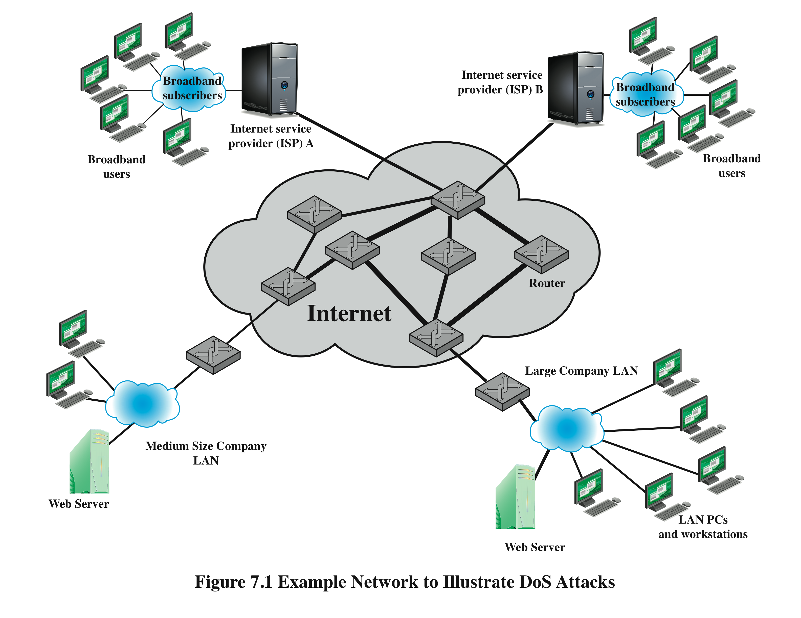
Notes:
Figure 7.1
Example Network to Illustrate DoS Attacks

Slide 25
A. Classic Denial-of-Service Attacks
flooding ping command
aim of this attack is to overwhelm the capacity of the network connection to the target organization
traffic can be handled by higher capacity links on the path, but packets are discarded as capacity decreases
source of the attack is clearly identified unless a spoofed address is used
network performance is noticeably affected
Notes:
The simplest classical DoS attack is a flooding attack on an organization. The aim
of this attack is to overwhelm the capacity of the network connection to the target
organization. If the attacker has access to a system with a higher-capacity network
connection, then this system can likely generate a higher volume of traffic than the
lower-capacity target connection can handle. For example, in the network shown
in Figure 7.1 , the attacker might use the large company’s Web server to target the
medium-sized company with a lower-capacity network connection. The attack might
be as simple as using a flooding ping 1 command directed at the Web server in the
target company. This traffic can be handled by the higher-capacity links on the path
between them, until the final router in the Internet cloud is reached. At this point
some packets must be discarded, with the remainder consuming most of the capacity
on the link to the medium-sized company. Other valid traffic will have little chance
of surviving discard as the router responds to the resulting congestion on this link.
In this classic ping flood attack, the source of the attack is clearly identified
since its address is used as the source address in the ICMP echo request packets. This
has two disadvantages from the attacker’s perspective. First, the source of the attack
is explicitly identified, increasing the chance that the attacker can be identified and
legal action taken in response. Second, the targeted system will attempt to respond to
the packets being sent. In the case of any ICMP echo request packets received by the
server, it would respond to each with an ICMP echo response packet directed back
to the sender. This effectively reflects the attack back at the source system. Since
the source system has a higher network bandwidth, it is more likely to survive this
reflected attack. However, its network performance will be noticeably affected, again
increasing the chances of the attack being detected and action taken in response. For
both of these reasons the attacker would like to hide the identity of the source system.
This means that any such attack packets need to use a falsified, or spoofed, address.

Slide 26
B-1. Source Address Spoofing
use forged source addresses
usually via the raw socket interface on operating systems
makes attacking systems harder to identify
attacker generates large volumes of packets that have the target system as the destination address
congestion would result in the router connected to the final, lower capacity link
requires network engineers to specifically query flow information from their routers
backscatter traffic
advertise routes to unused IP addresses to monitor attack traffic
Notes:
A common characteristic of packets used in many types of DoS attacks is the use
of forged source addresses. This is known as source address spoofing. Given sufficiently
privileged access to the network handling code on a computer system, it
is easy to create packets with a forged source address (and indeed any other attribute
that is desired). This type of access is usually via the raw socket interface on
many operating systems. This interface was provided for custom network testing
and research into network protocols. It is not needed for normal network operation.
However, for reasons of historical compatibility and inertia, this interface has been
maintained in many current operating systems. Having this standard interface available
greatly eases the task of any attacker trying to generate packets with forged
attributes. Otherwise an attacker would most likely need to install a custom device
driver on the source system to obtain this level of access to the network, which is
much more error prone and dependent on operating system version.
Given raw access to the network interface, the attacker now generates large
volumes of packets. These would all have the target system as the destination
address but would use randomly selected, usually different, source addresses for
each packet. Consider the flooding ping example from the previous section. These
custom ICMP echo request packets would flow over the same path from the source
toward the target system. The same congestion would result in the router connected
to the final, lower capacity link. However, the ICMP echo response packets, generated
in response to those packets reaching the target system, would no longer
be reflected back to the source system. Rather they would be scattered across the
Internet to all the various forged source addresses. Some of these addresses might
correspond to real systems. These might respond with some form of error packet,
since they were not expecting to see the response packet received. This only adds to
the flood of traffic directed at the target system. Some of the addresses may not be
used or may not reachable. For these, ICMP destination unreachable packets might
be sent back. Or these packets might simply be discarded. 2 Any response packets
returned only add to the flood of traffic directed at the target system.
Also, the use of packets with forged source addresses means the attacking
system is much harder to identify. The attack packets seem to have originated at
addresses scattered across the Internet. Hence, just inspecting each packet’s header
is not sufficient to identify its source. Rather the flow of packets of some specific
form through the routers along the path from the source to the target system must
be identified. This requires the cooperation of the network engineers managing all
these routers and is a much harder task than simply reading off the source address.
It is not a task that can be automatically requested by the packet recipients. Rather
it usually requires the network engineers to specifically query flow information
from their routers. This is a manual process that takes time and effort to organize.
It is worth considering why such easy forgery of source addresses is allowed on
the Internet. It dates back to the development of TCP/IP, which occurred in a generally
cooperative, trusting environment. TCP/IP simply does not include the ability,
by default, to ensure that the source address in a packet really does correspond with
that of the originating system. It is possible to impose filtering on routers to ensure
this (or at least that source network address is valid). However, this filtering 3 needs
to be imposed as close to the originating system as possible, where the knowledge
of valid source addresses is as accurate as possible. In general, this should occur at
the point where an organization’s network connects to the wider Internet, at the
borders of the ISP’s providing this connection. Despite this being a long-standing
security recommendation to combat problems such as DoS attacks, many ISPs
do not implement such filtering. As a consequence, attacks using spoofed-source
packets continue to occur frequently.
There is a useful side effect of this scattering of response packets to some
origi nal flow of spoofed-source packets. Security researchers, such as those with the
Honeynet Project, have taken blocks of unused IP addresses, advertised routes to
them, and then collected details of any packets sent to these addresses. Since no real
systems use these addresses, no legitimate packets should be directed to them. Any
packets received might simply be corrupted. It is much more likely, though, that
they are the direct or indirect result of network attacks. The ICMP echo response
packets generated in response to a ping flood using randomly spoofed source
addresses is a good example. This is known as backscatter traffic . Monitoring the
type of packets gives valuable information on the type and scale of attacks being
used, as described by [MOOR06], for example. This information is being used to
develop responses to the attacks being seen.

Slide 27
B-2. SYN Spoofing
common DoS attack
attacks the ability of a server to respond to future connection requests by overflowing the tables used to manage them
thus legitimate users are denied access to the server
an attack on system resources, specifically the network handling code in the operating system
Notes:
Along with the basic flooding attack, the other common classic DoS attack is the
SYN spoofing attack. This attacks the ability of a network server to respond to TCP
connection requests by overflowing the tables used to manage such connections.
This means future connection requests from legitimate users fail, denying them
access to the server. It is thus an attack on system resources, specifically the network
handling code in the operating system.

Slide 28
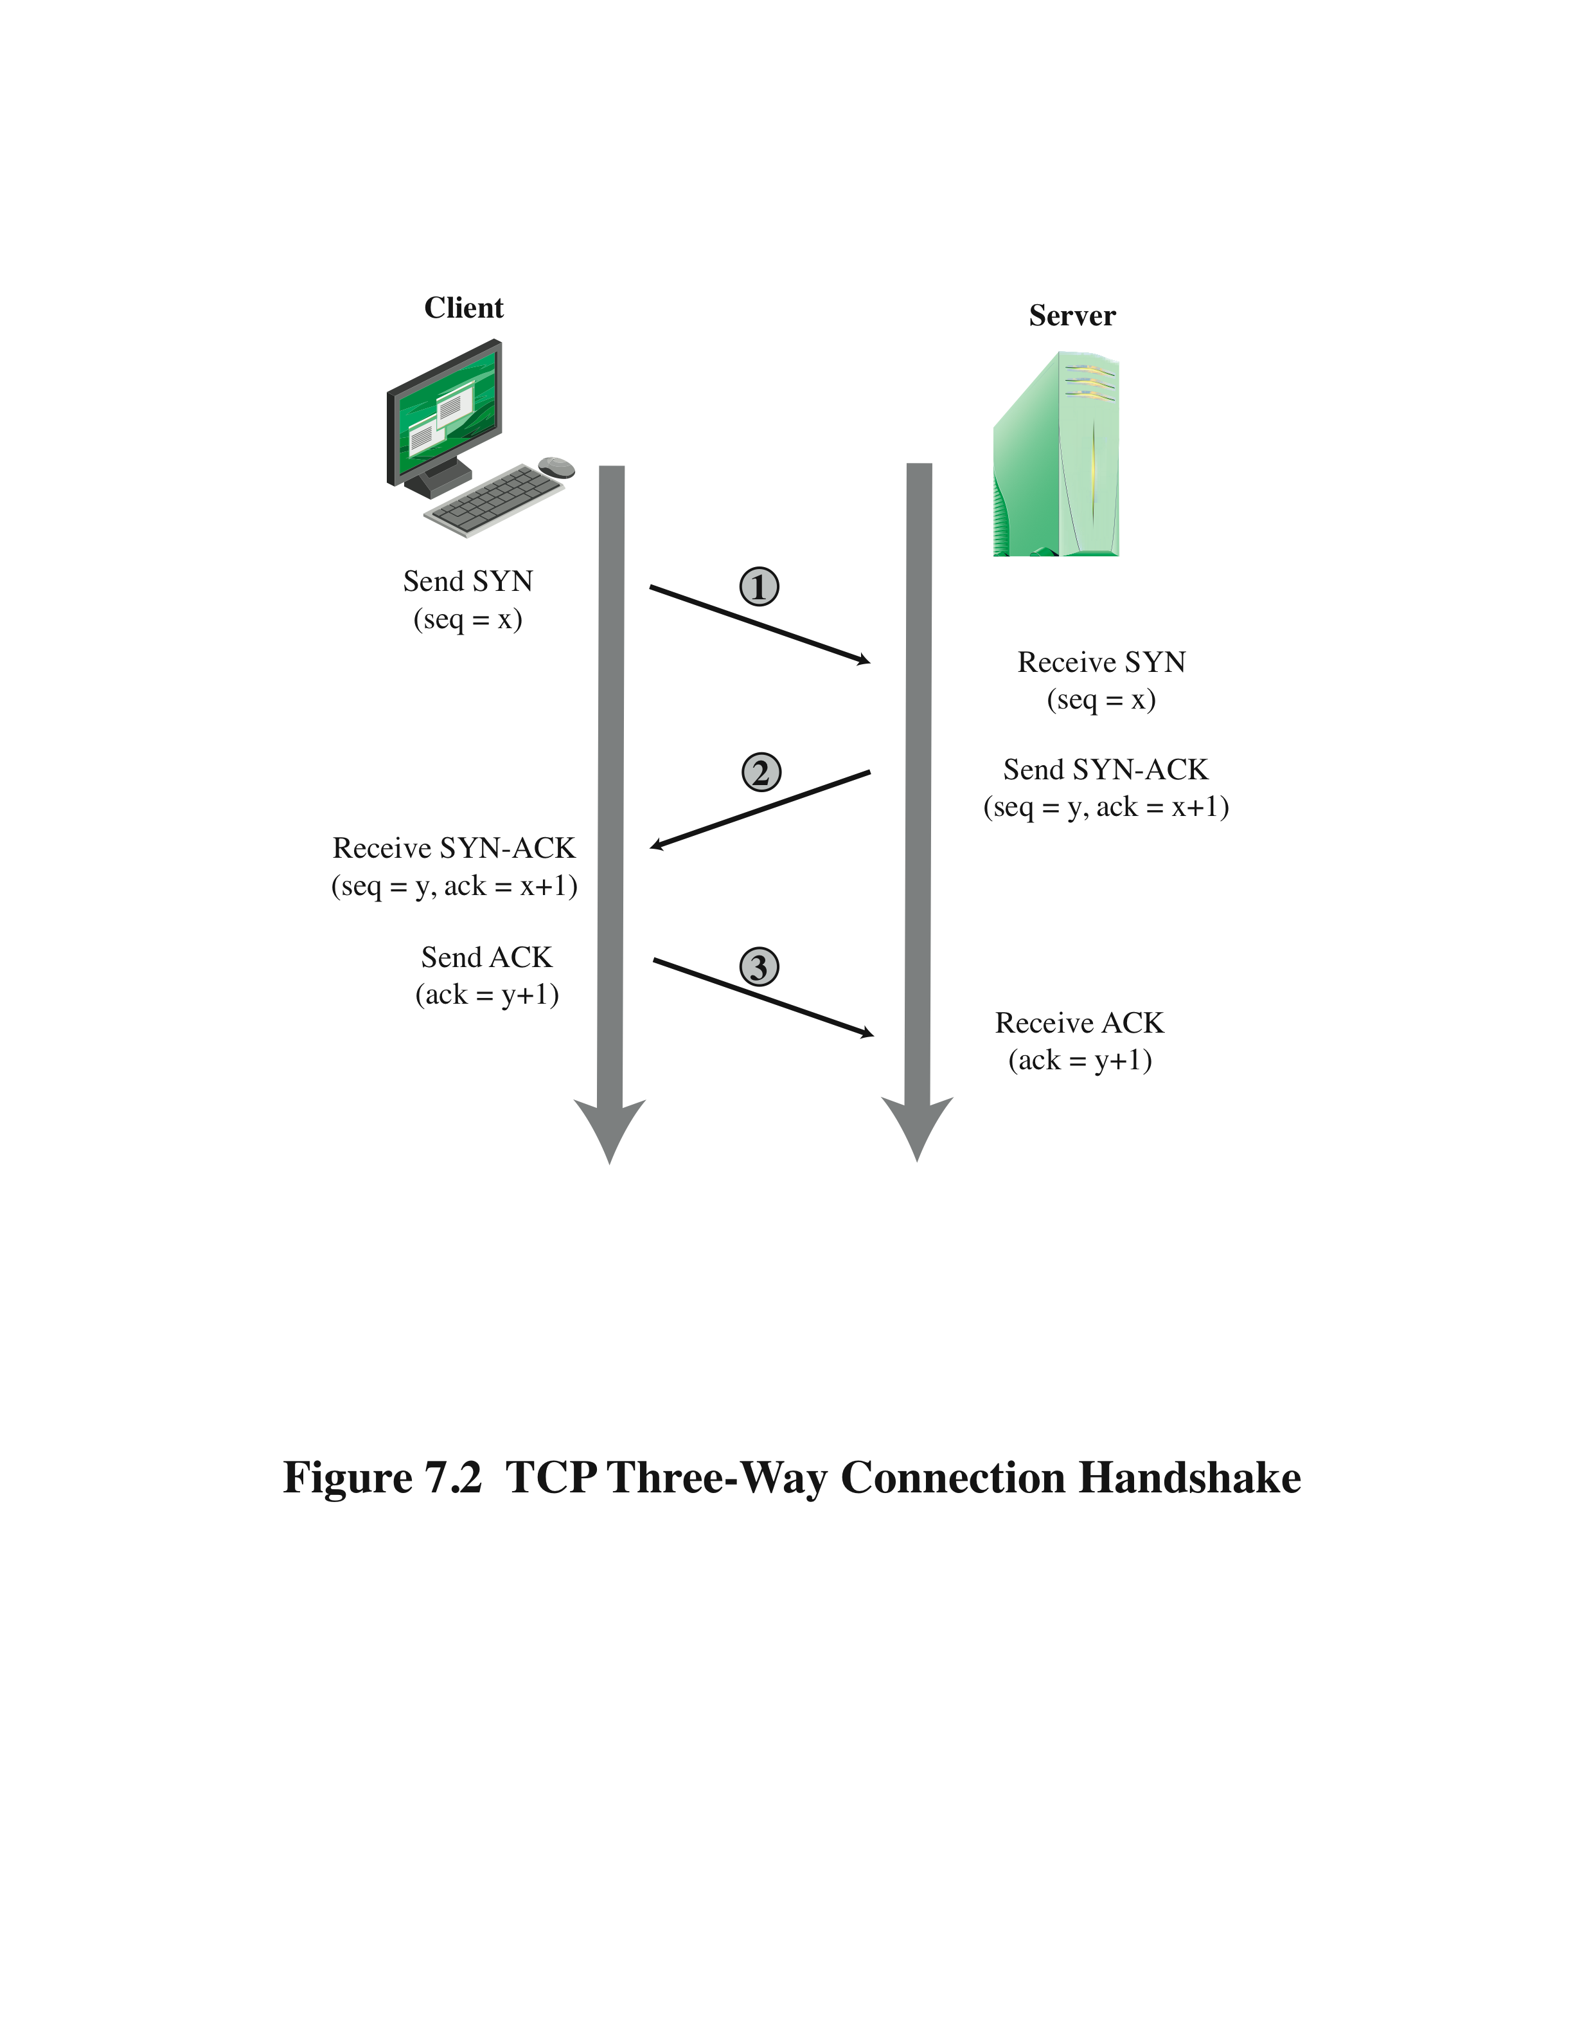
B-2. TCP Connection Handshake
Notes:
To understand the operation of these attacks, we need to review the three-way
handshake that TCP uses to establish a connection. This is illustrated in Figure 7.2 .
The client system initiates the request for a TCP connection by sending a SYN packet
to the server. This identifies the client’s address and port number and supplies an
initial sequence number. It may also include a request for other TCP options. The
server records all the details about this request in a table of known TCP connections.
It then responds to the client with a SYN-ACK packet. This includes a sequence
number for the server and increments the client’s sequence number to confirm receipt
of the SYN packet. Once the client receives this, it sends an ACK packet to the server
with an incremented server sequence number and marks the connection as established.
Likewise, when the server receives this ACK packet, it also marks the connection
as established. Either party may then proceed with data transfer. In practice, this
ideal exchange sometimes fails. These packets are transported using IP, which is an
unreliable, though best-effort, network protocol. Any of the packets might be lost in
transit, as a result of congestion, for example. Hence both the client and server keep
track of which packets they have sent and, if no response is received in a reasonable
time, will resend those packets. As a result, TCP is a reliable transport protocol, and
any applications using it need not concern themselves with problems of lost or reordered
packets. This does, however, impose an overhead on the systems in managing
this reliable transfer of packets.

Slide 29
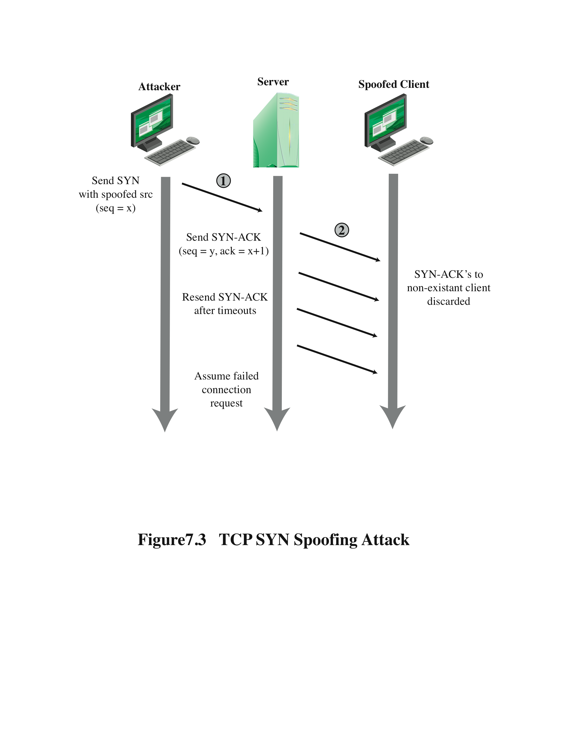
B-2 - TCP SYN Spoofing Attack
Notes:
A SYN spoofing attack exploits this behavior on the targeted server system.
The attacker generates a number of SYN connection request packets with forged
source addresses. For each of these the server records the details of the TCP connection
request and sends the SYN-ACK packet to the claimed source address,
as shown in Figure 7.3 . If there is a valid system at this address, it will respond
with a RST (reset) packet to cancel this unknown connection request. When the
server receives this packet, it cancels the connection request and removes the saved
information. However, if the source system is too busy, or there is no system at the
forged address, then no reply will return. In these cases the server will resend the
SYN-ACK packet a number of times before finally assuming the connection request
has failed and deleting the information saved concerning it. In this period between
when the original SYN packet is received and when the server assumes the request
has failed, the server is using an entry in its table of known TCP connections. This
table is typically sized on the assumption that most connection requests quickly
succeed and that a reasonable number of requests may be handled simultaneously.
However, in a SYN spoofing attack, the attacker directs a very large number of
forged connection requests at the targeted server. These rapidly fill the table of
known TCP connections on the server. Once this table is full, any future requests,
including legitimate requests from other users, are rejected. The table entries will
time out and be removed, which in normal network usage corrects temporary
overflow problems. However, if the attacker keeps a sufficient volume of forged
requests flowing, this table will be constantly full and the server will be effectively
cut off from the Internet, unable to respond to most legitimate connection requests.
In order to increase the usage of the known TCP connections table, the
attacker ideally wishes to use addresses that will not respond to the SYN-ACK with
a RST. This can be done by overloading the host that owns the chosen spoofed
source address, or by simply using a wide range of random addresses. In this case,
the attacker relies on the fact that there are many unused addresses on the Internet.
Consequently, a reasonable proportion of randomly generated addresses will not
correspond to a real host.
There is a significant difference in the volume of network traffic between a
SYN spoof attack and the basic flooding attack we discussed. The actual volume of
SYN traffic can be comparatively low, nowhere near the maximum capacity of the
link to the server. It simply has to be high enough to keep the known TCP connections
table filled. Unlike the flooding attack, this means the attacker does not need
access to a high-volume network connection. In the network shown in Figure 7.1 ,
the medium-sized organization, or even a broadband home user, could successfully
attack the large company server using a SYN spoofing attack.
A flood of packets from a single server or a SYN spoofing attack originating
on a single system were probably the two most common early forms of DoS attacks.
In the case of a flooding attack this was a significant limitation, and attacks evolved
to use multiple systems to increase their effectiveness. We next examine in more
detail some of the variants of a flooding attack. These can be launched either from a
single or multiple systems, using a range of mechanisms, which we explore.

Slide 30
C. Flooding Attacks
classified based on network protocol used
intent is to overload the network capacity on some link to a server
virtually any type of network packet can be used
Notes:
Flooding attacks take a variety of forms, based on which network protocol is being
used to implement the attack. In all cases the intent is generally to overload the
network capacity on some link to a server. The attack may alternatively aim to
overload the server’s ability to handle and respond to this traffic. These attacks flood
the network link to the server with a torrent of malicious packets competing with, and
usually overwhelming, valid traffic flowing to the server. In response to the congestion
this causes in some routers on the path to the targeted server, many packets will be
dropped. Valid traffic has a low probability of surviving discard caused by this flood
and hence of accessing the server. This results in the server’s ability to respond to
network connection requests being either severely degraded or failing entirely.
Virtually any type of network packet can be used in a flooding attack. It simply
needs to be of a type that is permitted to flow over the links toward the targeted system,
so that it can consume all available capacity on some link to the target server. Indeed,
the larger the packet, the more effective is the attack. Common flooding attacks use
any of the ICMP, UDP, or TCP SYN packet types. It is even possible to flood with
some other IP packet type. However, as these are less common and their usage more
targeted, it is easier to filter for them and hence hinder or block such attacks.
The ping flood using ICMP echo request packets we discuss in Section 7.1 is a classic
example of an ICMP flooding attack. This type of ICMP packet was chosen since
traditionally network administrators allowed such packets into their networks, as
ping is a useful network diagnostic tool. More recently, many organizations have
restricted the ability of these packets to pass through their firewalls. In response,
attackers have started using other ICMP packet types. Since some of these should
be handled to allow the correct operation of TCP/IP, they are much more likely to
be allowed through an organization’s firewall. Filtering some of these critical ICMP
packet types would degrade or break normal TCP/IP network behavior. ICMP
destination unreachable and time exceeded packets are examples of such critical
packet types.
An attacker can generate large volumes of one of these packet types. Because
these packets include part of some notional erroneous packet that supposedly
caused the error being reported, they can be made comparatively large, increasing
their effectiveness in flooding the link.
An alternative to using ICMP packets is to use UDP packets directed to some port
number, and hence potential service, on the target system. A common choice was a
packet directed at the diagnostic echo service, commonly enabled on many server
systems by default. If the server had this service running, it would respond with a
UDP packet back to the claimed source containing the original packet data contents.
If the service is not running, then the packet is discarded, and possibly an
ICMP destination unreachable packet is returned to the sender. By then the attack
has already achieved its goal of occupying capacity on the link to the server. Just
about any UDP port number can be used for this end. Any packets generated in
response only serve to increase the load on the server and its network links.
Spoofed source addresses are normally used if the attack is generated using
a single source system, for the same reasons as with ICMP attacks. If multiple systems
are used for the attack, often the real addresses of the compromised, zombie,
systems are used. When multiple systems are used, the consequences of both the
reflected flow of packets and the ability to identify the attacker are reduced.
Another alternative is to send TCP packets to the target system. Most likely these
would be normal TCP connection requests, with either real or spoofed source
addresses. They would have an effect similar to the SYN spoofing attack we’ve
described. In this case, though, it is the total volume of packets that is the aim of the
attack rather than the system code. This is the difference between a SYN spoofing
attack and a SYN flooding attack.
This attack could also use TCP data packets, which would be rejected by the
server as not belonging to any known connection. But again, by this time the attack
has already succeeded in flooding the links to the server.
All of these flooding attack variants are limited in the total volume of traffic
that can be generated if just a single system is used to launch the attack. The use
of a single system also means the attacker is easier to trace. For these reasons, a
variety of more sophisticated attacks, involving multiple attacking systems, have
been developed. By using multiple systems, the attacker can significantly scale up
the volume of traffic that can be generated. Each of these systems need not be particularly
powerful or on a high-capacity link. But what they don’t have individually,
they more than compensate for in large numbers. Also, by directing the attack
through intermediaries, the attacker is further distanced from the target and significantly
harder to locate and identify. Indirect attack types that utilize multiple
systems include
• Distributed denial-of-service attacks
• Reflector attacks
• Amplifier attacks
We consider each of these in turn.

Slide 31
C. Flooding Attacks
ICMP flood
ping flood using ICMP echo request packets
traditionally network administrators allow such packets into their networks because ping is a useful diagnostic tool
UDP flood
uses UDP packets directed to some port number on the target system
TCP SYN flood
sends TCP packets to the target system
total volume of packets is the aim of the attack rather than the system code

Slide 32
1. Distributed Denial of Service Attacks
use of multiple systems to generate attacks
attacker uses a flaw in operating system or in a common application to gain access and installs their program on it (zombie)
large collections of such systems under the control of one attacker’s control can be created
forming a botnet
Notes:
Recognizing the limitations of flooding attacks generated by a single system, one
of the earlier significant developments in DoS attack tools was the use of multiple
systems to generate attacks. These systems were typically compromised user workstations
or PCs. The attacker used some well-known flaw in the operating system or
in some common application to gain access to these systems and to install his or her
own programs on it. Such systems are known as zombies. Once suitable backdoor
programs were installed on these systems, they were entirely under the attacker’s
control. Large collections of such systems under the control of one attacker can be
created, collectively forming a botnet, as we discuss in Chapter 6 . Such networks of
compromised systems are a favorite tool of attacker, and can be used for a variety
of purposes, including distributed denial-of-service (DDoS) attacks. In the example
network shown in Figure 7.1 , some of the broadband user systems may be compromised
and used as zombies to attack any of the company or other links shown.
Many other DDoS tools have been developed since. Instead of using dedicated
handler programs, many now use an IRC 4 or similar instant messaging server
program to manage communications with the agents. Many of these more recent
tools also use cryptographic mechanisms to authenticate the agents to the handlers,
in order to hinder analysis of command traffic.
The best defense against being an unwitting participant in a DDoS attack is to
prevent your systems from being compromised. This requires good system security
practices and keeping the operating systems and applications on such systems current
and patched.
For the target of a DDoS attack, the response is the same as for any flooding
attack, but with greater volume and complexity. We discuss appropriate defenses
and responses in Sections 7.5 and 7.6 .

Slide 33
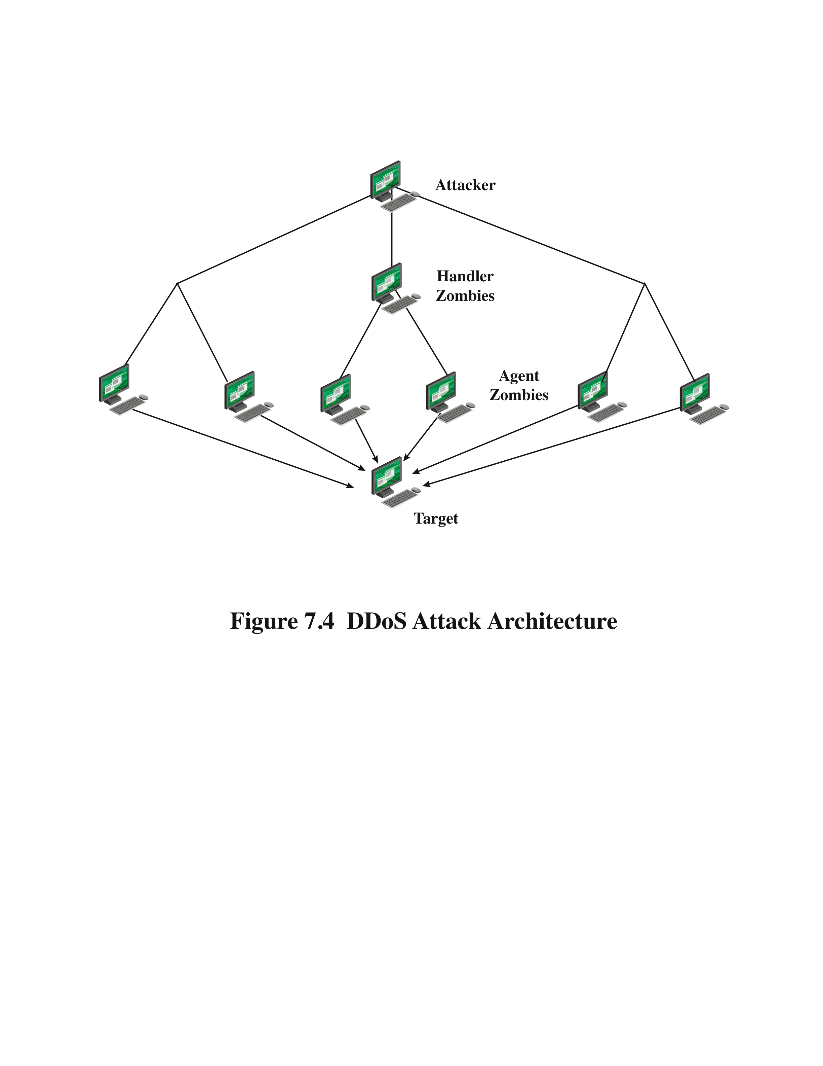
1. DDoS Attack Architecture
Notes:
While the attacker could command each zombie individually, more generally
a control hierarchy is used. A small number of systems act as handlers controlling a
much larger number of agent systems, as shown in Figure 7.4 . There are a number of
advantages to this arrangement. The attacker can send a single command to a handler,
which then automatically forwards it to all the agents under its control. Automated
infection tools can also be used to scan for and compromise suitable zombie systems,
as we discuss in Chapter 6 . Once the agent software is uploaded to a newly compromised
system, it can contact one or more handlers to automatically notify them of its
availability. By this means, the attacker can automatically grow suitable botnets.

Slide 34
2. Reflection Attacks
attacker sends packets to a known service on the intermediary with a spoofed source address of the actual target system
when intermediary responds, the response is sent to the target
“reflects” the attack off the intermediary (reflector)
goal is to generate enough volumes of packets to flood the link to the target system without alerting the intermediary
the basic defense against these attacks is blocking spoofed-source packets
Notes:
In contrast to DDoS attacks, where the intermediaries are compromised systems
running the attacker’s programs, reflector and amplifier attacks use network systems
functioning normally. The attacker sends a network packet with a spoofed source
address to a service running on some network server. The server responds to this
packet, sending it to the spoofed source address that belongs to the actual attack
target. If the attacker sends a number of requests to a number of servers, all with the
same spoofed source address, the resulting flood of responses can overwhelm the
target’s network link. The fact that normal server systems are being used as intermediaries,
and that their handling of the packets is entirely conventional, means
these attacks can be easier to deploy and harder to trace back to the actual attacker.
There are two basic variants of this type of attack: the simple reflection attack and
the amplification attack.
The reflection attack is a direct implementation of this type of attack. The attacker
sends packets to a known service on the intermediary with a spoofed source address
of the actual target system. When the intermediary responds, the response is sent to
the target. Effectively this reflects the attack off the intermediary, which is termed
the reflector, and is why this is called a reflection attack.
Ideally the attacker would like to use a service that created a larger response
packet than the original request. This allows the attacker to convert a lower volume
stream of packets from the originating system into a higher volume of packet data
from the intermediary directed at the target. Common UDP services are often used
for this purpose. Originally the echo service was a favored choice, although it does
not create a larger response packet. However, any generally accessible UDP service
could be used for this type of attack. The chargen, DNS, SNMP, or ISAKMP 6
services have all been exploited in this manner, in part because they can be made to
generate larger response packets directed at the target.
The intermediary systems are often chosen to be high-capacity network servers
or routers with very good network connections. This means they can generate
high volumes of traffic if necessary, and if not, the attack traffic can be obscured in
the normal high volumes of traffic flowing through them. If the attacker spreads the
attack over a number of intermediaries in a cyclic manner, then the attack traffic
flow may well not be easily distinguished from the other traffic flowing from the
system. This, combined with the use of spoofed source addresses, greatly increases
the difficulty of any attempt to trace the packet flows back to the attacker’s system.
Another variant of reflection attack uses TCP SYN packets and exploits the
normal three-way handshake used to establish a TCP connection. The attacker sends
a number of SYN packets with spoofed source addresses to the chosen intermediaries.
In turn the intermediaries respond with a SYN-ACK packet to the spoofed
source address, which is actually the target system. The attacker uses this attack
with a number of intermediaries. The aim is to generate high enough volumes of
packets to flood the link to the target system. The target system will respond with a
RST packet for any that get through, but by then the attack has already succeeded
in overwhelming the target’s network link.
This attack variant is a flooding attack that differs from the SYN spoofing
attack we discussed earlier in this chapter. The goal is to flood the network link
to the target, not to exhaust its network handling resources. Indeed, the attacker
would usually take care to limit the volume of traffic to any particular intermediary
to ensure that it is not overwhelmed by, or even notices, this traffic. This is both
because its continued correct functioning is an essential component of this attack,
as is limiting the chance of the attacker’s actions being detected. The 2002 attack on
GRC.com was of this form. It used connection requests to the BGP routing service
on core routers as the primary intermediaries. These generated sufficient response
traffic to completely block normal access to GRC.com. However, as GRC.com
discovered, once this traffic was blocked, a range of other services, on other intermediaries,
were also being used. GRC noted in its report on this attack that “you
know you’re in trouble when packet floods are competing to flood you.”
Any generally accessible TCP service can be used in this type of attack. Given
the large number of servers available on the Internet, including many well-known
servers with very high capacity network links, there are many possible intermediaries
that can be used. What makes this attack even more effective is that the
individual TCP connection requests are indistinguishable from normal connection
requests directed to the server. It is only if they are running some form of intrusion
detection system that detects the large numbers of failed connection requests from
one system that this attack might be detected and possibly blocked. If the attacker is
using a number of intermediaries, then it is very likely that even if some detect and
block the attack, many others will not, and the attack will still succeed.

Slide 35
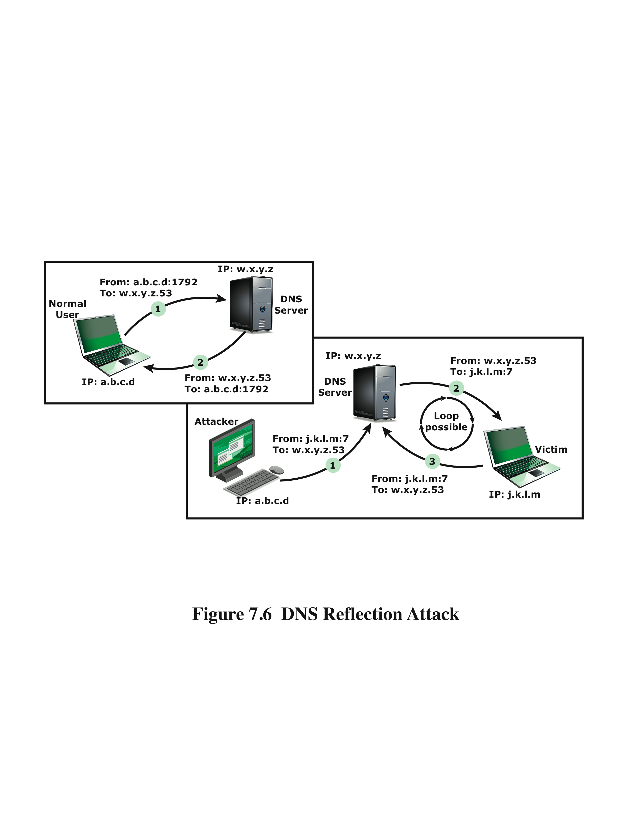
2.DNS Reflection Attacks
Notes:
A further variation of the reflector attack establishes a self-contained loop
between the intermediary and the target system. Both systems act as reflectors.
Figure 7.6 , based on [SCAR08], shows this type of attack. The upper part of the
figure shows normal Domain Name System operation. 7 The DNS client sends a
query from its UDP port 1792 to the server’s DNS port 53 to obtain the IP address
of a domain name. The DNS server sends a UDP response packet including the
IP address. The lower part of the figure shows a reflection attack using DNS.
The attacker sends a query to the DNS server with a spoofed IP source address
of j.k.l.m; this is the IP address of the target. The attacker uses port 7, which is
usually associated with echo, a reflector service. The DNS server then sends a
response to the victim of the attack, j.k.l.m, addressed to port 7. If the victim is
offering the echo service, it may create a packet that echoes the received data back
to the DNS server. This can cause a loop between the DNS server and the victim if
the DNS server responds to the packets sent by the victim. Most reflector attacks
can be prevented through network-based and host-based firewall rulesets that
reject suspicious combinations of source and destination ports.
While very effective if possible, this type of attack is fairly easy to filter for
because the combinations of service ports used should never occur in normal network
operation.
When implementing any of these reflection attacks, the attacker could use just
one system as the original source of packets. This suffices, particularly if a service is used
that generates larger response packets than those originally sent to the intermediary.
Alternatively, multiple systems might be used to generate higher volumes of traffic
to be reflected and to further obscure the path back to the attacker. Typically a botnet
would be used in this case.
Another characteristic of reflection attacks is the lack of backscatter traffic.
In both direct flooding attacks and SYN spoofing attacks, the use of spoofed
source addresses results in response packets being scattered across the Internet and
thus detectable. This allows security researchers to estimate the volumes of such
attacks. In reflection attacks, the spoofed source address directs all the packets at
the desired target and any responses to the intermediary. There is no generally visible
side effect of these attacks, making them much harder to quantify. Evidence of
them is only available from either the targeted systems and their ISPs or the intermediary
systems. In either case, specific instrumentation and monitoring would be
needed to collect this evidence.
Fundamental to the success of reflection attacks is the ability to create
spoofed-source packets. If filters are in place that block spoofed-source packets,
then these attacks are simply not possible. This is the most basic, fundamental
defense against such attacks. This is not the case with either SYN spoofing or flooding
attacks (distributed or not). They can succeed using real source addresses, with
the consequences already noted.

Slide 36
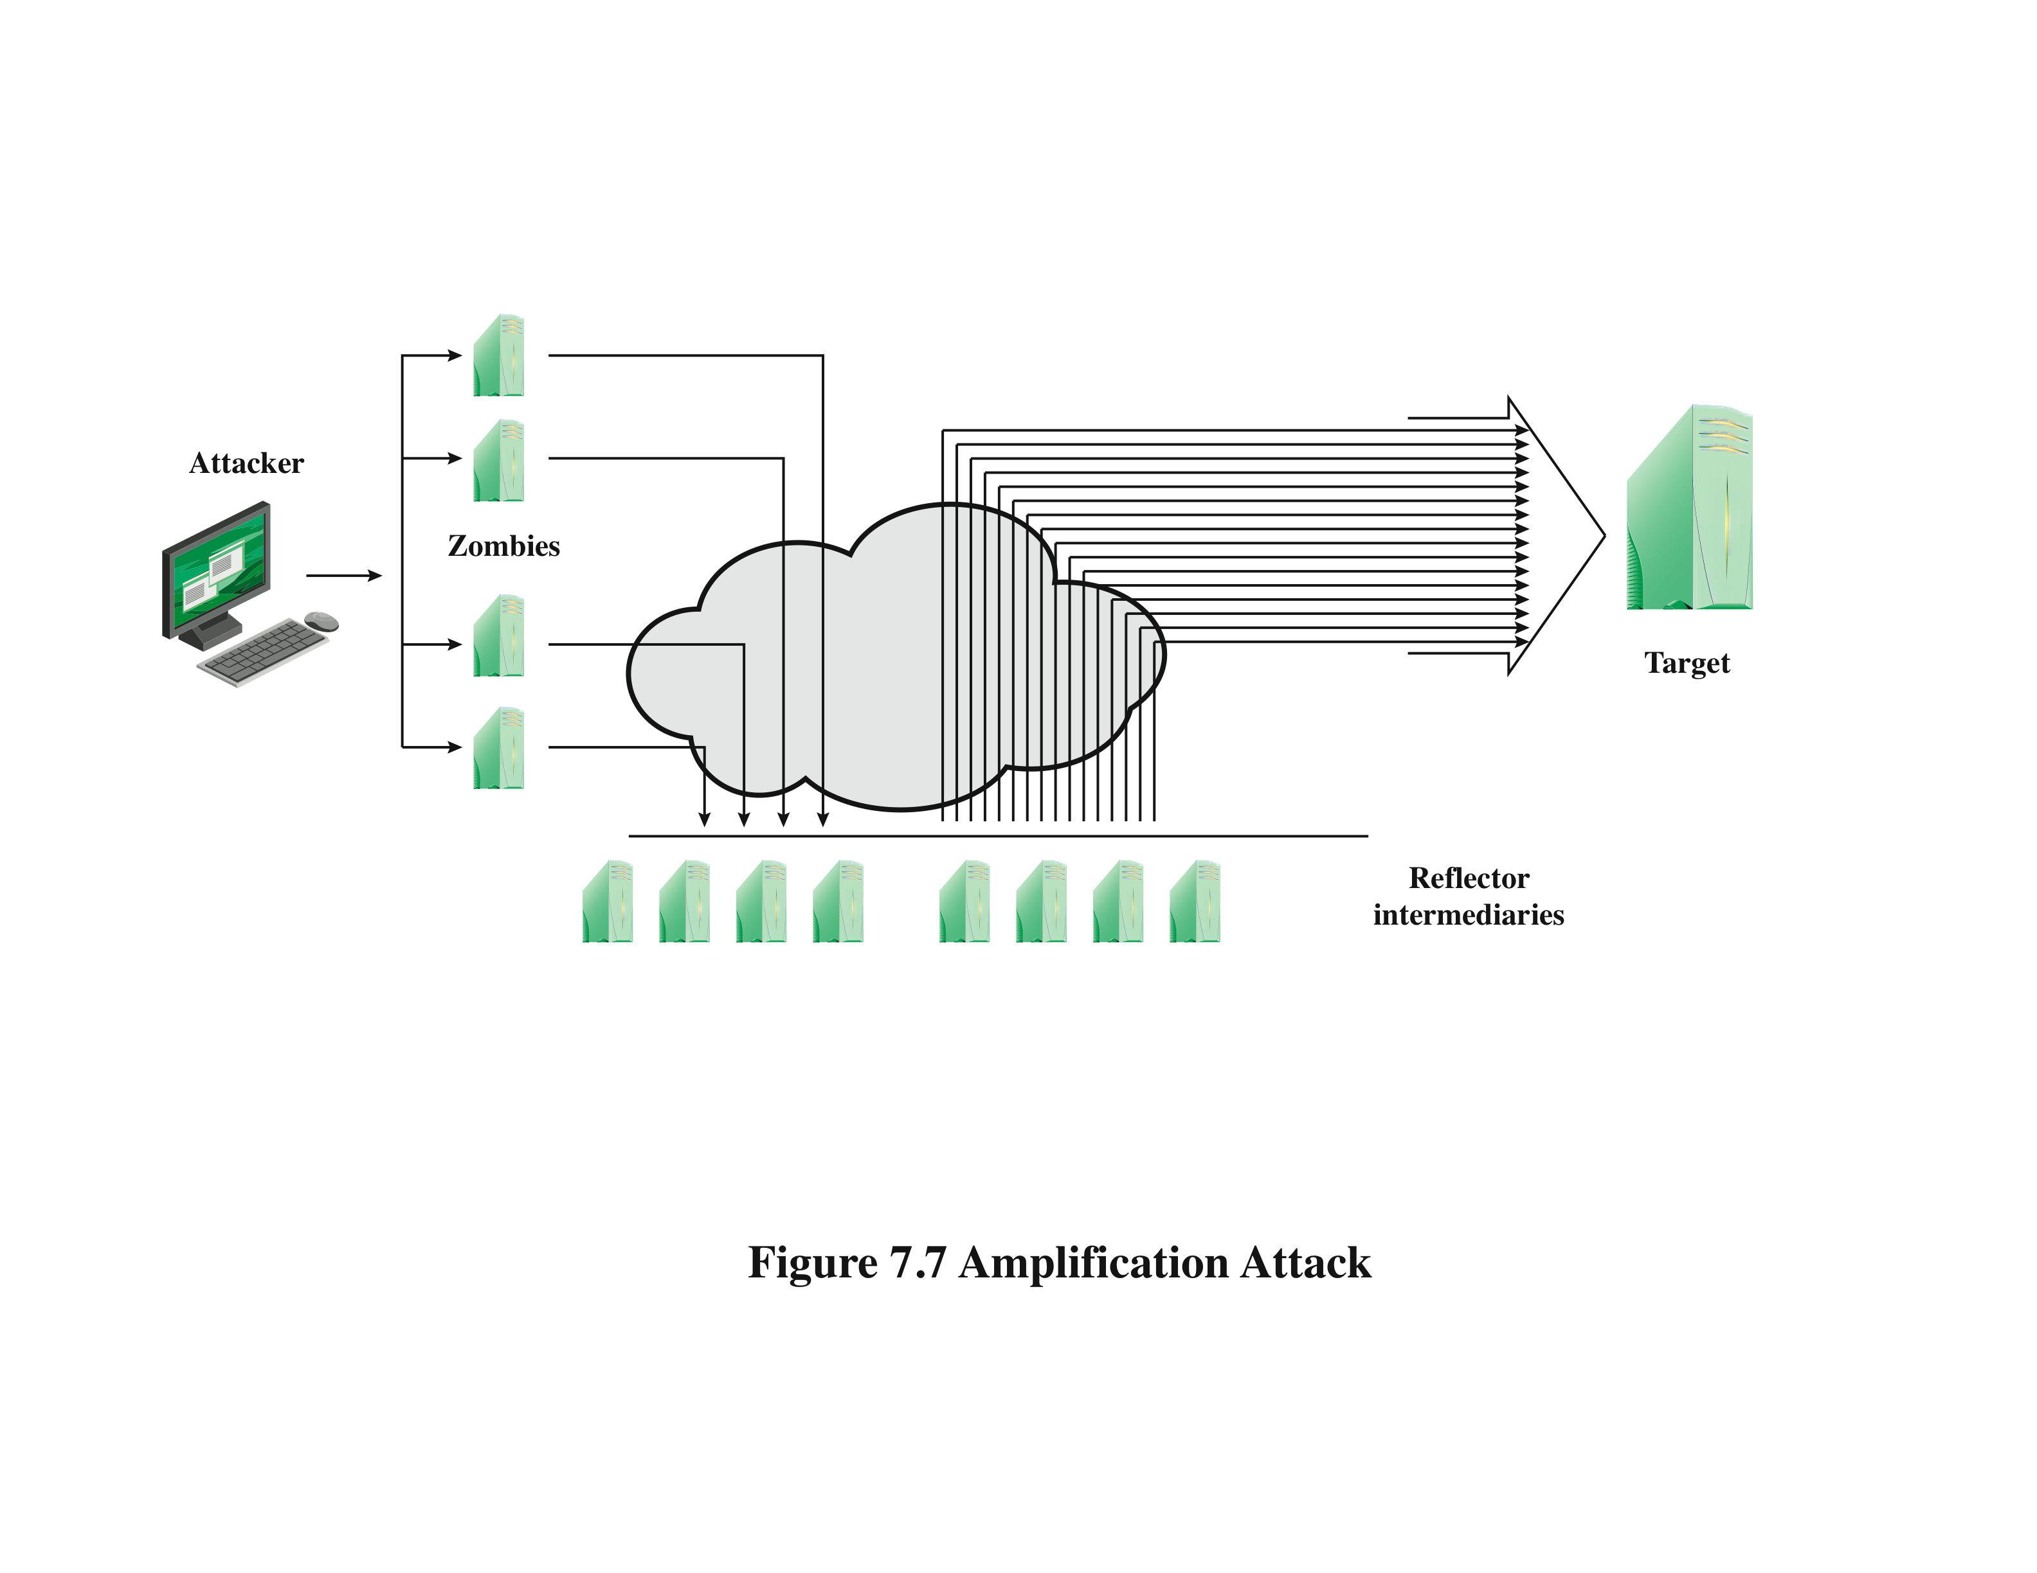
3. Amplification Attacks
Notes:
Amplification attacks are a variant of reflector attacks and also involve sending a
packet with a spoofed source address for the target system to intermediaries. They
differ in generating multiple response packets for each original packet sent. This can
be achieved by directing the original request to the broadcast address for some network.
As a result, all hosts on that network can potentially respond to the request,
generating a flood of responses as shown in Figure 7.7 . It is only necessary to use
a service handled by large numbers of hosts on the intermediate network. A ping
flood using ICMP echo request packets was a common choice, since this service
is a fundamental component of TCP/IP implementations and was often allowed
into networks. The well-known smurf DoS program used this mechanism and was
widely popular for some time. Another possibility is to use a suitable UDP service,
such as the echo service. The fraggle program implemented this variant. Note that
TCP services cannot be used in this type of attack; because they are connection
oriented, they cannot be directed at a broadcast address. Broadcasts are inherently
connectionless.
The best additional defense against this form of attack is to not allow directed
broadcasts to be routed into a network from outside. Indeed, this is another longstanding
security recommendation, unfortunately about as widely implemented as
that for blocking spoofed source addresses. If these forms of filtering are in place,
these attacks cannot succeed. Another defense is to limit network services like echo
and ping from being accessed from outside an organization. This restricts which
services could be used in these attacks, at a cost in ease of analyzing some legitimate
network problems.
Attackers scan the Internet looking for well-connected networks that do allow
directed broadcasts and that implement suitable services attackers can reflect off.
These lists are traded and used to implement such attacks.

Slide 37
3. DNS Amplification Attacks
use packets directed at a legitimate DNS server as the intermediary system
attacker creates a series of DNS requests containing the spoofed source address of the target system
exploit DNS behavior to convert a small request to a much larger response (amplification)
target is flooded with responses
basic defense against this attack is to prevent the use of spoofed source addresses
Notes:
In addition to the DNS reflection attack discussed previously, a further variant of an
amplification attack uses packets directed at a legitimate DNS server as the intermediary
system. Attackers gain attack amplification by exploiting the behavior of the
DNS protocol to convert a small request into a much larger response. This contrasts
with the original amplifier attacks, which use responses from multiple systems to a
single request to gain amplification. Using the classic DNS protocol, a 60-byte UDP
request packet can easily result in a 512-byte UDP response, the maximum traditionally
allowed. All that is needed is a name server with DNS records large enough for
this to occur.
These attacks have been seen for several years. More recently, the DNS
protocol has been extended to allow much larger responses of over 4000 bytes to
support extended DNS features such as IPv6, security, and others. By targeting
servers that support the extended DNS protocol, significantly greater amplification
can be achieved than with the classic DNS protocol.
In this attack, a selection of suitable DNS servers with good network connections
are chosen. The attacker creates a series of DNS requests containing
the spoofed source address of the target system. These are directed at a number
of the selected name servers. The servers respond to these requests, sending the
replies to the spoofed source, which appears to them to be the legitimate requesting
system. The target is then flooded with their responses. Because of the amplification
achieved, the attacker need only generate a moderate flow of packets to
cause a larger, amplified flow to flood and overflow the link to the target system.
Intermediate systems will also experience significant loads. By using a number of
high-capacity, well-connected systems, the attacker can ensure that intermediate
systems are not overloaded, allowing the attack to proceed.
A further variant of this attack exploits recursive DNS name servers. This is
a basic feature of the DNS protocol that permits a DNS name server to query a
number of other servers to resolve a query for its clients. The intention was that this
feature is used to support local clients only. However, many DNS systems support
recursion by default for any requests. They are known as open recursive DNS servers.
Attackers may exploit such servers for a number of DNS-based attacks, including
the DNS amplification DoS attack. In this variant, the attacker targets a number
of open recursive DNS servers. The name information being used for the attack
need not reside on these servers, but can be sourced from anywhere on the Internet.
The results are directed at the desired target using spoofed source addresses.
Like all the reflection-based attacks, the basic defense against these is to prevent
the use of spoofed source addresses. Appropriate configuration of DNS servers,
in particular limiting recursive responses to internal client systems only, can
restrict some variants of this attack.

Slide 38
DoS Attack Defenses
these attacks cannot be prevented entirely
attack prevention and preemption
before attack
attack detection and filtering
during the attack
attack source traceback and identification
during and after the attack
attack reaction
after the attack
Notes:
There are a number of steps that can be taken both to limit the consequences of
being the target of a DoS attack and to limit the chance of your systems being compromised
and then used to launch DoS attacks. It is important to recognize that
these attacks cannot be prevented entirely. In particular, if an attacker can direct a
large enough volume of legitimate traffic to your system, then there is a high chance
this will overwhelm your system’s network connection, and thus limit legitimate
traffic requests from other users. Indeed, this sometimes occurs by accident as a
result of high publicity about a specific site. Classically, a posting to the well-known
Slashdot news aggregation site often results in overload of the referenced server
system. Similarly, when popular sporting events like the Olympics or Soccer World
Cup matches occur, sites reporting on them experience very high traffic levels. This
has led to the terms slashdotted , flash crowd , or flash event being used to describe
such occurrences. There is very little that can be done to prevent this type of either
accidental or deliberate overload without also compromising network performance.
The provision of significant excess network bandwidth and replicated distributed
servers is the usual response, particularly when the overload is anticipated. This is
regularly done for popular sporting sites. However, this response does have a significant
implementation cost.
In general, there are four lines of defense against DDoS attacks [PENG07,
CHAN02]:
• Attack prevention and preemption (before the attack): These mechanisms
enable the victim to endure attack attempts without denying service to legitimate
clients. Techniques include enforcing policies for resource consumption
and providing backup resources available on demand. In addition, prevention
mechanisms modify systems and protocols on the Internet to reduce the
possibility of DDoS attacks.
• Attack detection and filtering (during the attack): These mechanisms attempt
to detect the attack as it begins and respond immediately. This minimizes the
impact of the attack on the target. Detection involves looking for suspicious
patterns of behavior. Response involves filtering out packets likely to be part
of the attack.
• Attack source traceback and identification (during and after the attack): This
is an attempt to identify the source of the attack as a first step in preventing
future attacks. However, this method typically does not yield results fast
enough, if at all, to mitigate an ongoing attack.
• Attack reaction (after the attack): This is an attempt to eliminate or curtail the
effects of an attack.
We discuss the first of these lines of defense in this section and consider the
remaining three in Section 7.7 .

Slide 39
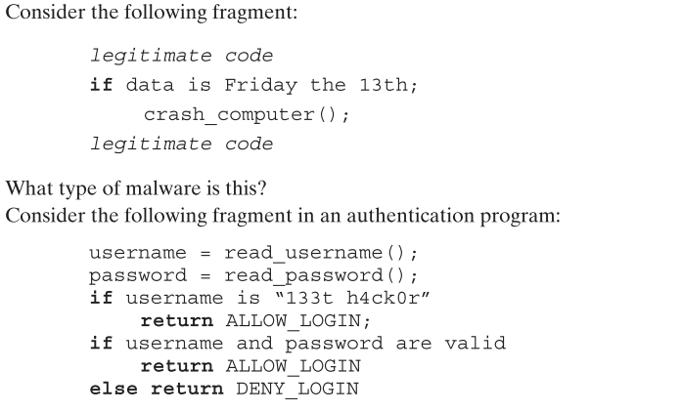
Homework
1
2
3. Differentiate between DDos and Reflection attacks with figures
Notes:
Chapter 6 summary.

